Slide 1
Meeting Challenges Through Technology & Innovation
Sarah Ekart & Gwenyth Johnson MS. RDN. LD.
Stronger Families for a Stronger Georgia
2/17/2016

Slide 2
Table of Contents
Section | Slide Number
What is Assistive Technology | 3
Categories of Assistive Technology | 4
Cost Effectiveness of Assistive Technology | 12
Toolkits | 13
Coastal Area Agency on Aging Assistive Technology Lab | 14
Upcoming | 15
Division of Aging Services
Georgia Department of Human Services
2

Slide 3
What is Assistive Technology
Assistive Technology (AT) is any item or piece of equipment that is used to increase, maintain or improve the functional capabilities of an individual
AT ranges from low technology to high technology devices
Division of Aging Services
Georgia Department of Human Services
3

Slide 4
Categories of Assistive Technology
Daily Living
Communication
Dexterity
Safety
Environmental Adaptions
Household
Division of Aging Services
Georgia Department of Human Services
4

Slide 5
Disclaimer
We do not endorse any specific product or brand. The products demonstrated here and in the Toolkits were selected by Georgia Tech Tools for Life based on their expertise as well as the popularity of the products though their experience and the features of the pieces of AT demonstrated. Each person has different needs and desires and we recommend testing multiple products and features to ensure the best fit for the individual.
Division of Aging Services
Georgia Department of Human Services
5

Slide 6
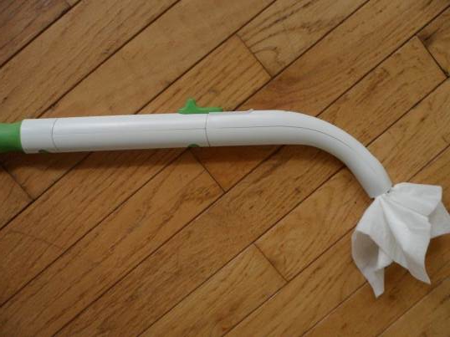
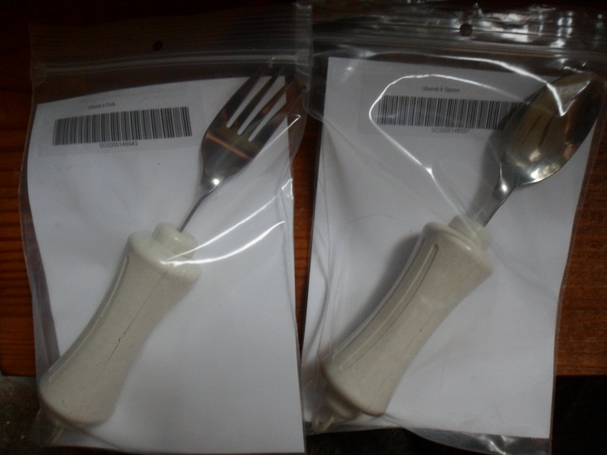
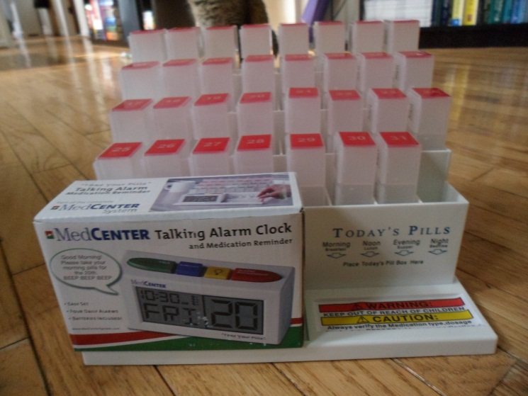
AT for Daily Living
Freedom Wand
Medication Reminders
Large Handle Silverware
Division of Aging Services
Georgia Department of Human Services
6

Slide 7
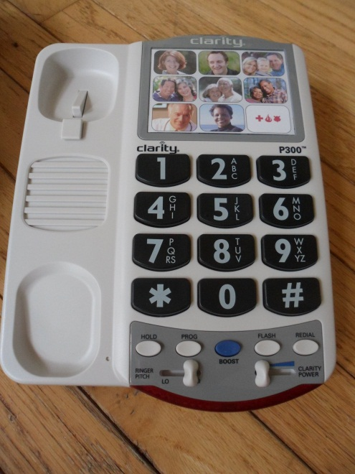
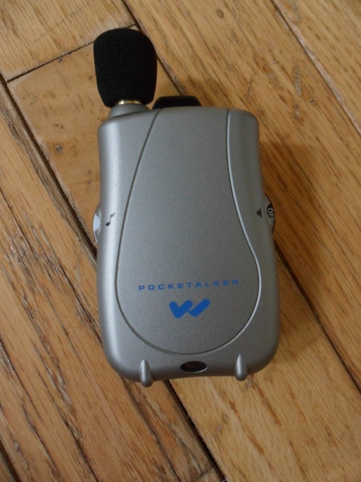
AT for Communications
Personal Amplifier
Picture Dialing Phones
Tablets
Division of Aging Services
Georgia Department of Human Services
7

Slide 8
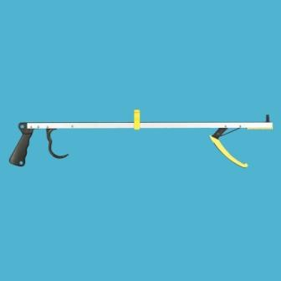
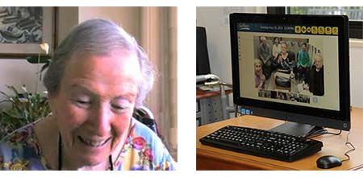
AT for Dexterity
Virtual Senior Centers
Reachers/Grabbers
Alternative Pointing Devices
Division of Aging Services
Georgia Department of Human Services
8

Slide 9
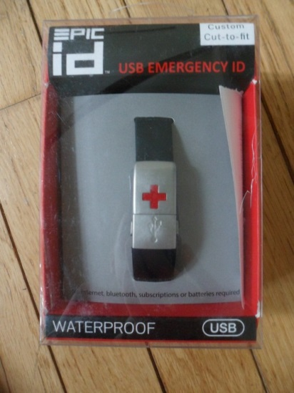
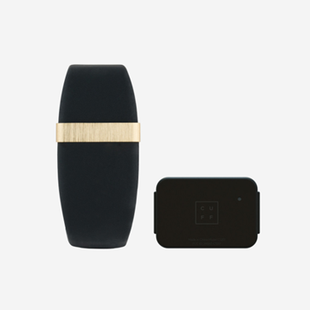
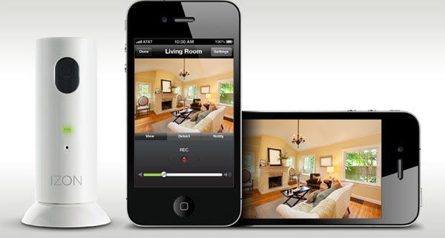
AT for Safety
Wearable Emergency ID
Security Camera System
Wearable Monitoring
Division of Aging Services
Georgia Department of Human Services
9

Slide 10
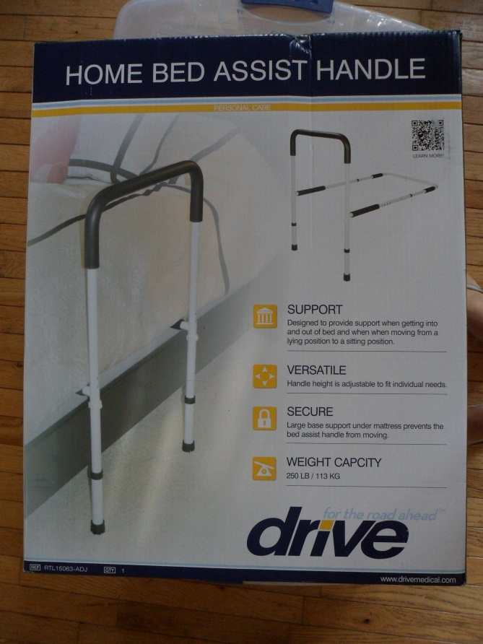
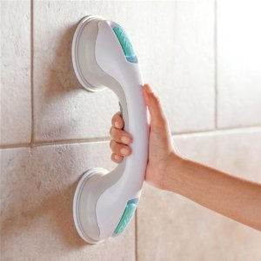
AT for Environmental Adaptions
Bed Rails
Grab Bars
Division of Aging Services
Georgia Department of Human Services
10

Slide 11
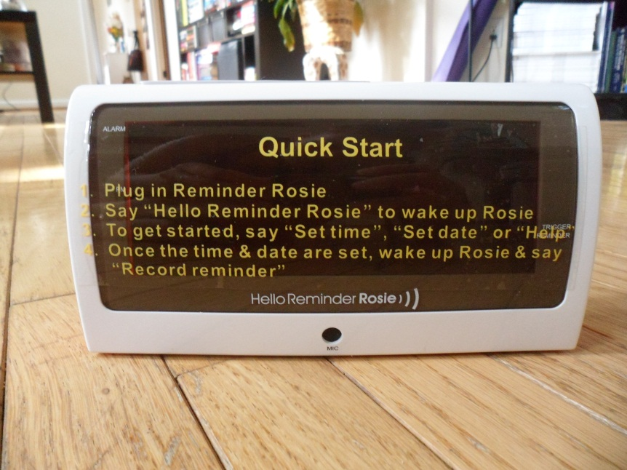
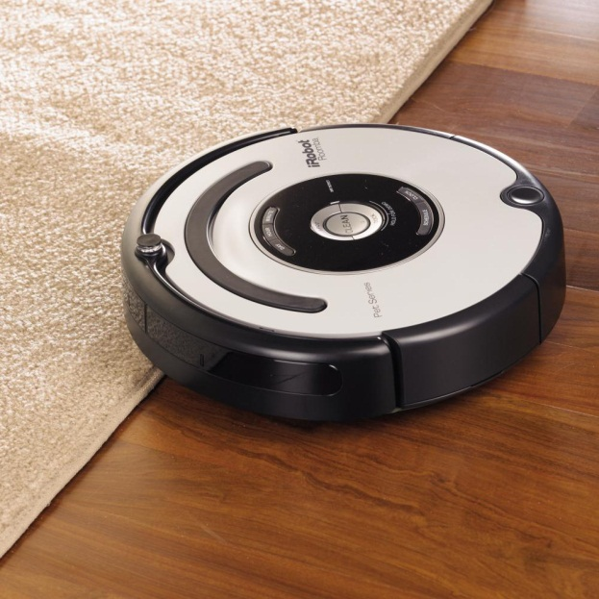
AT for Household
Reminder Alarms
Robotic Vacuum
Division of Aging Services
Georgia Department of Human Services
11

Slide 12
AT: a Cost Effective Means of Long-term Care
Average non-Medicaid Personal Care Service: $1,670/year
Average non-Medicaid Homemaker Service: $1,515/year
Less than $100 can purchase: handheld shower, shower chair, 2 grab bars and long handle sponge
Division of Aging Services
Georgia Department of Human Services
12

Slide 13
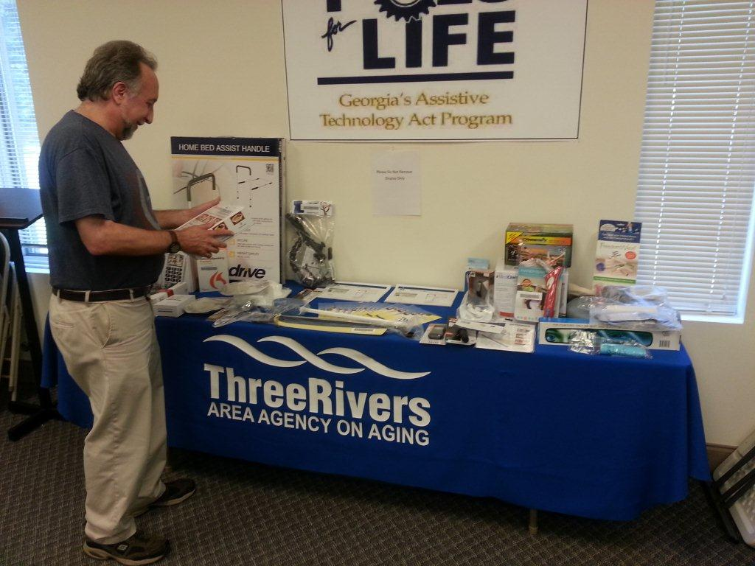
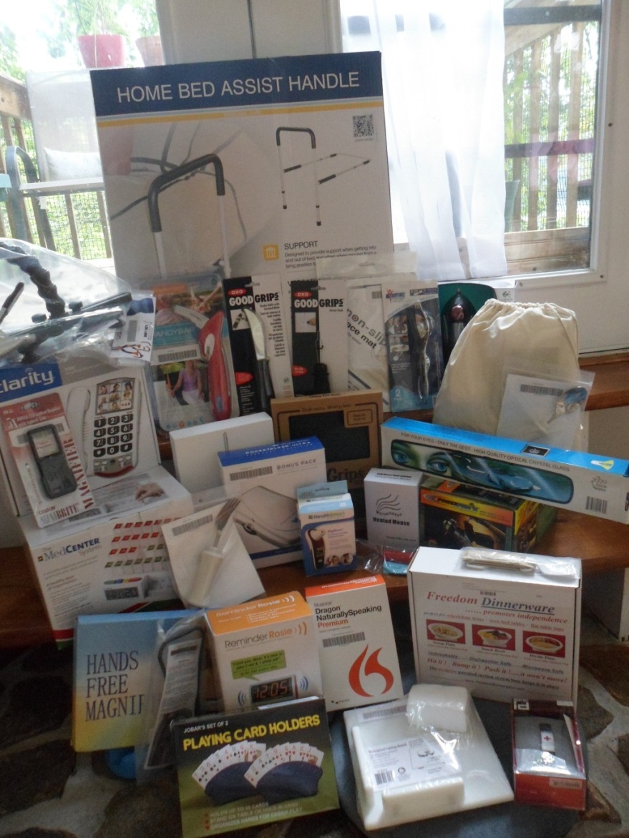
AT Toolkits
Division of Aging Services
Georgia Department of Human Services
13

Slide 14
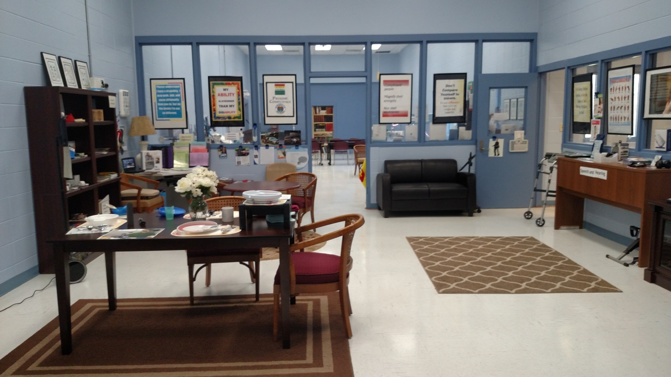
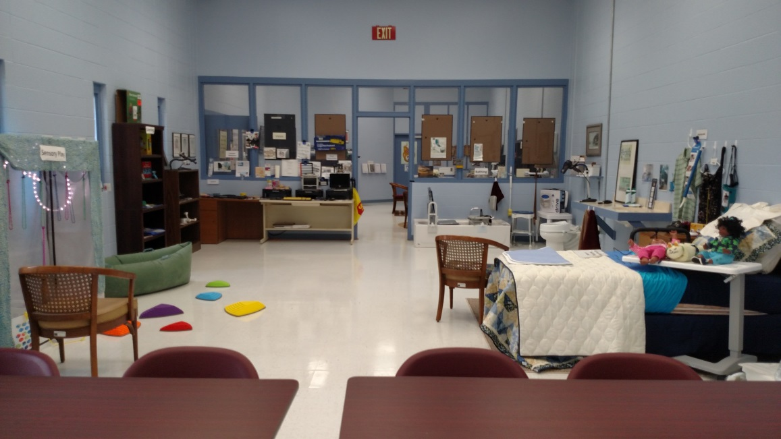
AT Lab – Coastal Area Agency on Aging
Division of Aging Services
Georgia Department of Human Services
14

Slide 15
Upcoming
Toolkit distribution and training for five remaining Area Agencies on Aging
Development of a feature matching tool
Pilot project between the Money Follows the Person program and Georgia Tech Tools for Life
Partnership with Microsoft
Division of Aging Services
Georgia Department of Human Services
15

Slide 16
For More Information
Tools for Life Website: http://www.gatfl.org/
Sarah Ekart
sarah.ekart@dhs.ga.gov
Gwenyth Johnson gwenyth.johnson@dhs.ga.gov
Division of Aging Services
Georgia Department of Human Services
15

