Slide 1

Division of Aging Services
Abby Cox
Director
Stronger Families for a Stronger Georgia
May 18, 2016

Slide 2

Vision, Mission and Core Values
Vision
Stronger Families for a Stronger Georgia.
Mission
Strengthen Georgia by providing Individuals and Families access to services that promote self-sufficiency, independence, and protect Georgia's vulnerable children and adults.
Core Values
Provide access to resources that offer support and empower Georgians and their families.
Deliver services professionally and treat all clients with dignity and respect.
Manage business operations effectively and efficiently by aligning resources across the agency.
Promote accountability, transparency and quality in all services we deliver and programs we administer.
Develop our employees at all levels of the agency.
Georgia Department of Human Services
2

Slide 3
Division of Aging Services
Vision
Living Longer, Living Safely, Living Well
Mission
The Georgia Department of Human Services (DHS) Division of Aging Services (DAS) supports the larger goals of DHS by assisting older individuals, at-risk adults, persons with disabilities and their families and caregivers to achieve safe, healthy, independent and self-reliant lives.
Core Values A strong customer focus Accountability and results Teamwork Open Communication Proactive Approach | Dignity and Respect Our Workforce Trust Diversity Empowerment
Division of Aging Services
Georgia Department of Human Services
3

Slide 4
Division of Aging Services
Division of Aging Services
Georgia Department of Human Services
4

Slide 5
Division of Aging Services
Division Structure
Division Legislative Authority
State Authority / Reference | O.C.G.A §49-6-1, et seq. (DAS), § 30-5-1 et seq. (APS)
Federal Authority / Reference | Older Americans Act of 1965, as amended, PL 89-73, 42 USC § 3001, et seq.
Division Demographics
Total Offices | 14 offices statewide
Total Staff | 264 filled as of 3/31/2016
Total Budget | SFY17 AOB: $87,675,405
Division of Aging Services
Georgia Department of Human Services
5

Slide 6
Division of Aging Services
Key Services
Access to Services
Adult Protective Services
Forensic Special Initiatives Unit
Livable Communities
Program Integrity
Public Guardianship
Regional Coordinators
Division of Aging Services
Georgia Department of Human Services
6

Slide 7
Division of Aging Services
Planning & Service Areas
Division of Aging Services
Georgia Department of Human Services
7

Slide 8
2016 - 2019 DAS Strategic Plan
Goals
Goal 1: Food Security
Description: Empower older adults to stay active and healthy by increasing food security and access to healthy food options
Strategies: Increase access to healthy food options for older adults by connecting them to local food systems Implement a person-centered approach to dining options Quarterly Supplemental Nutrition Assistance Program (SNAP) sign up days at senior centers Develop a partner group to support and implement a State Senior Hunger Summit Evaluate the extent of choice of dining options Expand the role of site councils to improve dining choices Adheres to Governor’s Goal of: Healthy – Accessible care and active lifestyles
Division of Aging Services
Georgia Department of Human Services
8

Slide 9
2016 - 2019 DAS Strategic Plan
Goals
Goal 2: Safety
Description: Ensure the protection and rights of older and disabled individuals who are victims of abuse, neglect and/or exploitation
Strategies: “Right size” staffing to regions with higher investigation intakes Target At-Risk Adult Crime Tactics (ACT) training to counties that do not have ACT certified law enforcement officers trained Develop a pilot train-the-trainer model to increase the number of ACT trainers without decreasing quality Facilitate multi-disciplinary work groups to identify barriers to addressing financial exploitation and other gaps in response to at risk adult abuse Develop an Elderly Legal Assistance Program (ELAP) educational/publicity plan or protocol to disseminate to targeted groups with targeted issues Adheres to Governor’s Goal of: Safe – Protecting the public’s safety and security
Division of Aging Services
Georgia Department of Human Services
9

Slide 10
2016 - 2019 DAS Strategic Plan
Goals
Goal 3: Self-Sufficiency
Description: Older adults and adults with disabilities will remain independent and in their desired residence as long as possible
Strategies: Identify and prioritize potential underserved populations to reach and offer services Options Counselors and Long-Term Care Ombudsman (LTCO) collaborate to assist nursing facility residents who have expressed interest in learning more about less restrictive housing options Expand service types and options available to consumers Implement a Kinship Care Continuum – including Voluntary Kinship Care Expand partnership with Centers for Independent Living for cross support in transition activities Enhance Public Guardianship Office (PGO) staff’s practice of determining the preference or wishes of a person under guardianship and incorporating that input into surrogate decision-making Refer cases that are more appropriate for less restrictive alternatives back to court Increase the number of multi-disciplinary/multi-agency groups in which PGO staff participates Adheres to Governor’s Goal of: Safe – Protecting the public’s safety and security
Division of Aging Services
Georgia Department of Human Services
10

Slide 11
2016 - 2019 DAS Strategic Plan
Goals
Goal 4: Network Sustainability
Description:. Programs and services will remain available for vulnerable adults in need
Strategies: Expand fee for service program model Implement evidence based hospital transition programs in all Area Agencies on Aging (AAAs) Monitor funding increases realized via fee for service options Explore senior centers serving as a hub Strengthen partnerships with SNAP and senior centers All senior centers will have a minimum of one SNAP sign-up day per quarter by 2019 Adheres to Governor’s Goal of: Safe – Protecting the public’s safety and security
Division of Aging Services
Georgia Department of Human Services
11

Slide 12
2016 - 2019 DAS Strategic Plan
Goals
Goal 5: Workforce Focus
Description:. Ensure that DAS maintains a learning environment with opportunities to increase professional growth, share knowledge and stimulate creative thinking
Strategies: Utilize annual Employee Satisfaction Survey (ESAT) to measure employee satisfaction Management team meeting to discuss ESAT results and develop strategies to increase satisfaction rates and adequately trained metrics Charter a team to begin planning and develop a succession planning protocol Adheres to Governor’s Goal of: Responsible and Efficient Government – Fiscally sound, principled, conservative
Division of Aging Services
Georgia Department of Human Services
12

Slide 13
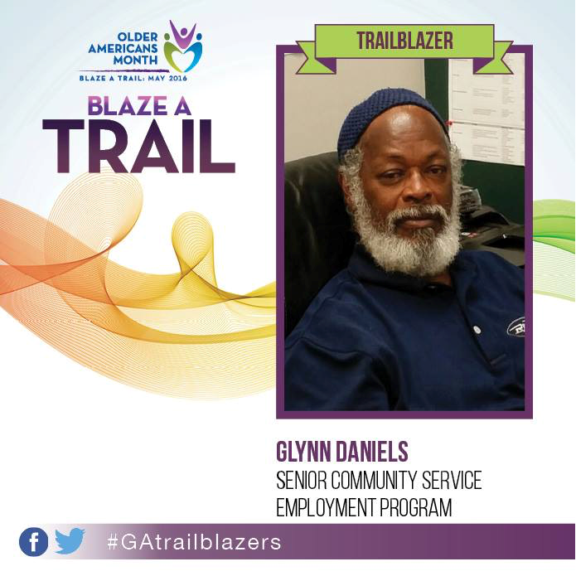
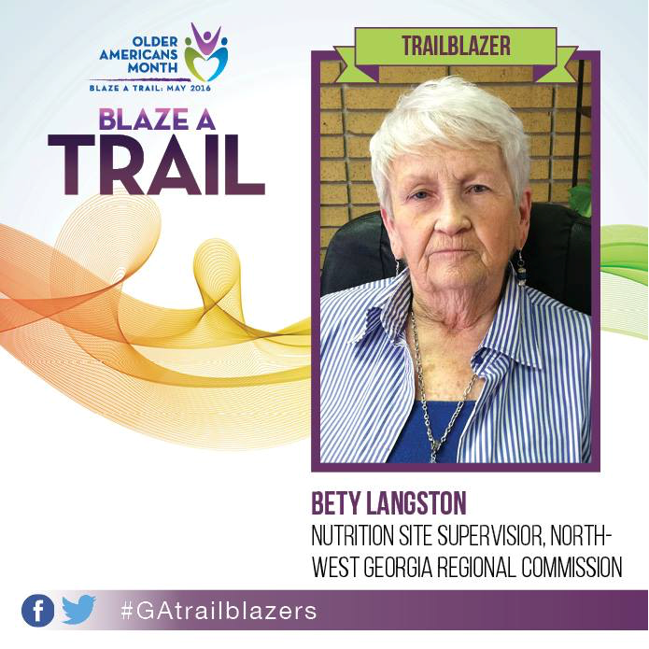
Division of Aging Services
Upcoming Events, Initiatives, Projects
May Older Americans Month Theme: Blaze a Trail
Division of Aging Services
Georgia Department of Human Services
13

Slide 14


Division of Aging Services
Upcoming Events, Initiatives, Projects
June Alzheimer’s and Brain Awareness Month
June 15: World Elder Abuse Awareness Day | June 30: Being Mortal Screening and Q&A
June 21 – 24: ADRC Healthy Aging Summit
September
Date TBD: Statewide Hunger Summit
Division of Aging Services
Georgia Department of Human Services
14

Slide 15
Questions???
Division of Aging Services
Georgia Department of Human Services
15

