Slide 1
Senior Hunger and
Food Insecurity in Georgia
Abby Cox, Director
8/24/2016

Slide 2

Vision, Mission and Core Values
Vision
Stronger Families for a Stronger Georgia.
Mission
Strengthen Georgia by providing Individuals and Families access to services that promote self-sufficiency, independence, and protect Georgia's vulnerable children and adults.
Core Values
Provide access to resources that offer support and empower Georgians and their families.
Deliver services professionally and treat all clients with dignity and respect.
Manage business operations effectively and efficiently by aligning resources across the agency.
Promote accountability, transparency and quality in all services we deliver and programs we administer.
Develop our employees at all levels of the agency.
Division of Aging Services
Georgia Department of Human Services
2

Slide 3
Division of Aging Services
Vision
Living Longer, Living Safely, Living Well
Mission
The Georgia Department of Human Services (DHS) Division of Aging Services (DAS) supports the larger goals of DHS by assisting older individuals, at-risk adults, persons with disabilities and their families and caregivers to achieve safe, healthy, independent and self-reliant lives.
Core Values A strong customer focus Accountability and results Teamwork Open Communication Proactive Approach | Dignity and Respect Our Workforce Trust Diversity Empowerment
Division of Aging Services
Georgia Department of Human Services
3

Slide 4
2016 - 2019 DAS Strategic Plan
Goals
Goal 1: Food Security
Description: Empower older adults to stay active and healthy by increasing food security and access to healthy food options
Strategies: Increase access to healthy food options for older adults by connecting them to local food systems Implement a person-centered approach to dining options Quarterly SNAP sign up days at senior centers Develop a partner group to support and implement a State Senior Hunger Summit Evaluate the extent of choice of dining options Expand the role of site councils to improve dining choices Adheres to Governor’s Goals of: Health – Accessible care and active lifestyles
Division of Aging Services
Georgia Department of Human Services
4
Notes:
As I start communicating with the aging network and those with whom we collaborate, it is helpful for me to keep our strategic plan in mind and our goals for 2016-2019. These goals have been carefully thought through and we have made sure they align with the Governor’s goals.

Slide 5

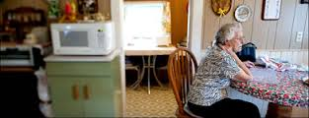

Senior Hunger and Food Insecurity
A complex relationship of food insecurity, older age, poverty, access to healthy appropriate food and more.
Division of Aging Services
Georgia Department of Human Services
5
Notes:
Millions of seniors struggle with hunger, isolation and the ability to pay for basic living needs.
From the USDA:
The CNSTAT panel also recommended that USDA make a clear and explicit distinction between food insecurity and hunger.
Food insecurity—the condition assessed in the food security survey and represented in USDA food security reports—is a household-level economic and social condition of limited or uncertain access to adequate food.
Hunger is an individual-level physiological condition that may result from food insecurity.

Slide 6

A National Problem
6
Notes:
According to the Meals on Wheels Association of America(MOWAA) 1 in 6 seniors struggles with hunger
We expect to see increases in these numbers as the older adult population grows.
The cost to provide meals for an older adult for an entire year is about the same as the cost of hospitalization for a single day.

Slide 7

A Georgia Problem
7
Notes:
Georgia has the 11th fastest growing 60+ population and the 10th fastest growing 85+ population in the United States between 2010-2030.
The MOWAA report estimates that 245,919 older adults or 16% are struggling with hunger
Approximately 24% (23.8%) or 395,714 of Georgia seniors live alone
Approximately 32% or 538,854 are living at or near the poverty line.
The number of seniors experiencing the threat of hunger increased by 119% between 2001 and 2011.
Georgia ranked 9th worst for senior hunger with 17.8% reporting food insecurity

Slide 8
Why is Senior Hunger An Issue in Georgia?
Georgia has issues with access to healthy, appropriate food in both urban and rural areas
  Food Deserts
  Rural Counties with few or no grocery stores
  Limited Transportation Options
  Too Few Seniors Enrolled in SNAP
Division of Aging Services
Georgia Department of Human Services
8

Slide 9
Food Insecurity by
Planning and Service Area
Overall 28.9% | Food Insecurity
PSA | % | Rank
1. Northwest Georgia | 42.70 | 1
2. Georgia Mountains | 38.85 | 2
7. Middle Georgia | 32.70 | 3
11. Southern Georgia | 31.71 | 4
12. Coastal Georgia | 31.17 | 5
6. River Valley | 28.56 | 6
10. SOWEGA | 27.68 | 7
3. Atlanta Region | 24.33 | 8
9. Heart of Georgia/Altamaha | 24.03 | 9
5. Northeast Georgia | 21.67 | 10
8. Central Savannah River | 20.52 | 11
4. Southern Crescent | 18.93 | 12
Division of Aging Services
Georgia Department of Human Services
9

Slide 10
Food Insecurity by County
Top 10 Counties
Bottom 10 Counties
 |  | Food Insecurity
PSA | County Name | % | Rank
10 | Thomas | 61.4 | 1
1 | Murray | 59.4 | 2
1 | Whitfield | 55.2 | 3
1 | Floyd | 51.8 | 4
1 | Bartow | 49.5 | 5
2 | Stephens | 48.2 | 6
1 | Pickens | 47.6 | 7
2 | Dawson | 46.6 | 8
2 | Hall | 46.1 | 9
2 | Banks | 45.7 | 10
 |  | Food Insecurity
PSA | County Name | % | Rank
8 | Hancock | 11.6 | 150
6 | Harris | 11.6 | 150
9 | Treutlen | 11.1 | 152
3 | Fayette | 10.7 | 153
3 | Cobb | 10.5 | 154
8 | Warren | 10.5 | 155
8 | Lincoln | 9.9 | 156
10 | Early | 9.3 | 157
10 | Lee | 8.2 | 158
8 | Taliaferro | 4.3 | 159
Division of Aging Services
Georgia Department of Human Services
10

Slide 11
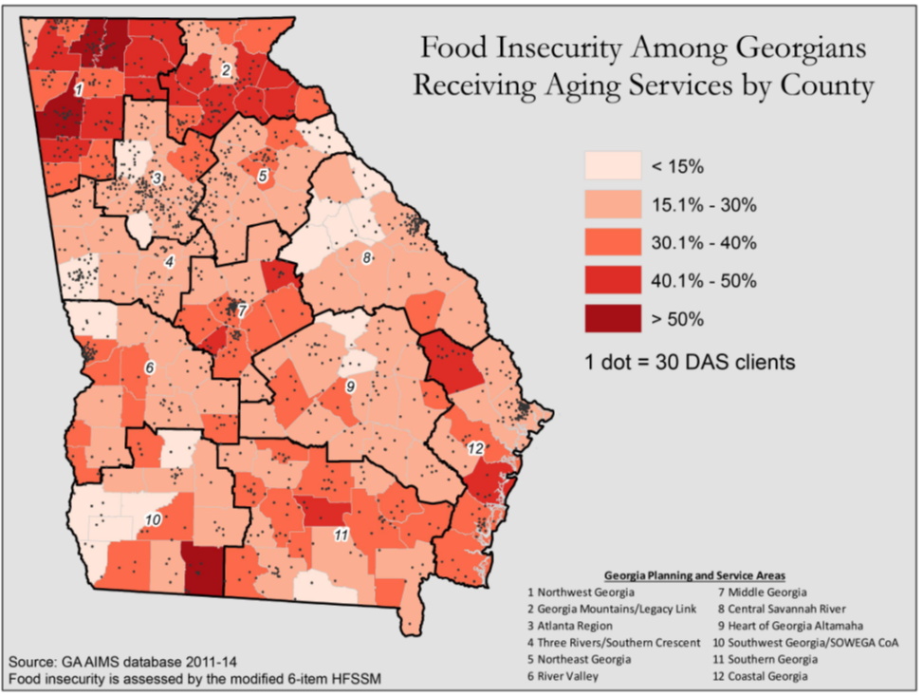
Food Insecurity among Older Georgians Receiving Aging Services by PSA and County
Division of Aging Services
Georgia Department of Human Services
11

Slide 12
Older Georgians Receiving Aging Services living in Food Deserts by Census Tract
Division of Aging Services
Georgia Department of Human Services
12

Slide 13

Division of Aging Services
Georgia Department of Human Services
13

Slide 14

Division of Aging Services
Georgia Department of Human Services
14
Notes:
3 out of 5 seniors who qualify for SNAP do not participate. Many seniors face barriers related to mobility, technology and stigma and are discouraged by widespread myths about how the program works and who can qualify.

Slide 15

Maximizing Margaret’s
SNAP Benefits with the SMED
Her Out-of-Pocket Medical Expenses
Total out-of-pocket-medical expenses: transportation, insurance premium, prescription co-pay, over-the-counter drugs and supplies | $321.13/mo
Her Expected SNAP Benefits
Without medical expense deduction | $28/mo*
With SMED | $96/mo*
*Based on benefit amounts and standards set in October 2015
Image: www.fotolia.com
15
Notes:
Let us look at how Margaret, a 64 year old single woman can use the medical expense deduction to get more SNAP benefits.
Margaret's total out-of-pocket medical expenses per month is $321.13
Without claiming any medical expenses this client would only qualify for $28 per month.
By simply verifying over $35 in out-of-pocket medical expenses per month, Margaret can receive $96 per month in SNAP benefits
If Margaret claimed her actual medical expenses, she could receive up to $157 per month.
The bottom line is that if Margaret could not provide verification of her total out-of-pocket expenses per month, she could simply provide verification of any of her expenses totaling more than $35 per month and she would be eligible for the standard medical expense deduction to receive $96 per month in benefits.
For many people, claiming the SMED or their actual expenses may mean MORE SNAP benefits each month

Slide 16

What Can Be Done?
Division of Aging Services
Georgia Department of Human Services
16

Slide 17
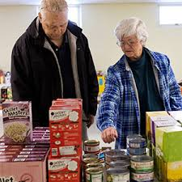
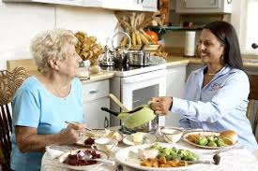
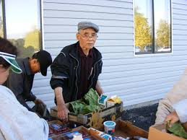
What Can Be Done?
Senior Hunger Workgroup October 2016-2019
Senior Hunger State Plan Development 2019
Develop community, regional and statewide partnerships
Division of Aging Services
Georgia Department of Human Services
17
Notes:
Health Care Industry
Food Industry
Aging Network
Faith Based Organizations
Legislators and Community Leaders
State Government Partners
Community Gardens and Farmers
Food Banks and other not for profit organizations

Slide 18
Questions?
Division of Aging Services
Georgia Department of Human Services
18

