Slide 1
Board of Human Services
Amended Fiscal Year 2022 & Fiscal Year 2023
R. Demetrius Taylor, Deputy Commissioner, Finance
Cliff O’Connor, Assistant Deputy Commissioner, Finance
2/16/2022
Notes:
Good afternoon Chairman Dempsey and Committee Members,
For those of you whom I have not met before, my name is Robyn Crittenden. I am commissioner of the Department of Human Services and I am here to present the Governor’s recommendation for the Department’s Amended Fiscal Year 2020 budget.

Slide 2
Office of the Commissioner
Notes:
For those of you who were recently appointed to the committee, or for those of you whom I may not have had the opportunity to meet - the Department of Human Services' vision is to build stronger families for a stronger Georgia.
With each policy, program and service we provide, we ask ourselves, "Does this help build stronger families, and as a result, a stronger Georgia?”

Slide 3
DHS State Fiscal Year 2022 Budget Allocations
Office of the Commissioner
Notes:
With that in mind, here's how we use our resources to accomplish our goals, adhere to the law governing our programs and hold ourselves accountable to the public trust.
DHS has about $1.7 billion allocated to protect and serve Georgia's vulnerable populations.
When you add the budgets of our attached entities, the total for the Department’s Fiscal Year 2022 budget allocation is roughly $1.9 billion.
Now, we will look at the Governor's recommendations for DHS and two of our attached entities, the Council on Aging and Safe Harbor for Sexually Exploited Children Fund Commission.
Georgia Vocational Rehabilitation Agency (GVRA) is also attached to DHS for administrative purposes. Questions concerning GVRA will need to be directed to Executive Director Chris Wells.

Slide 4
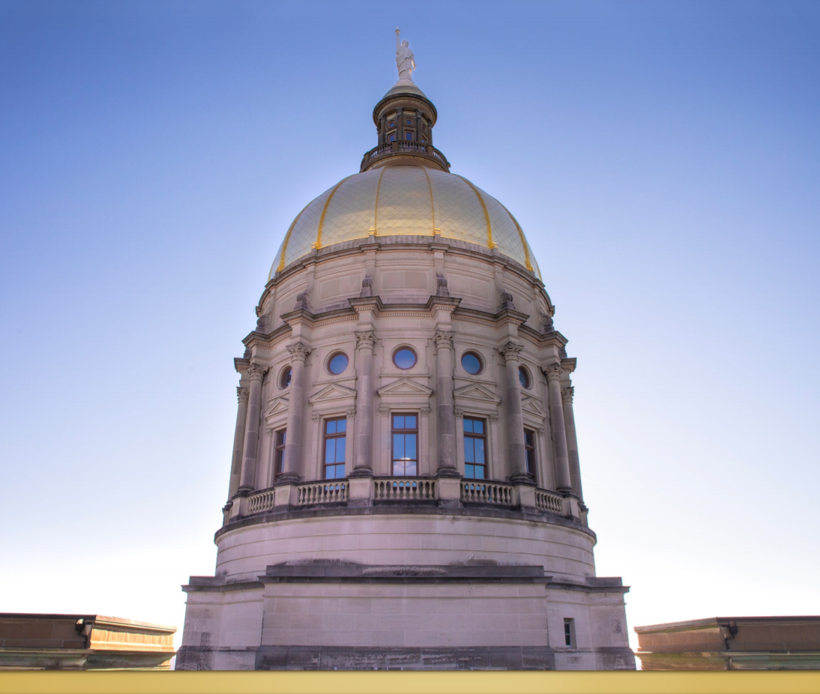
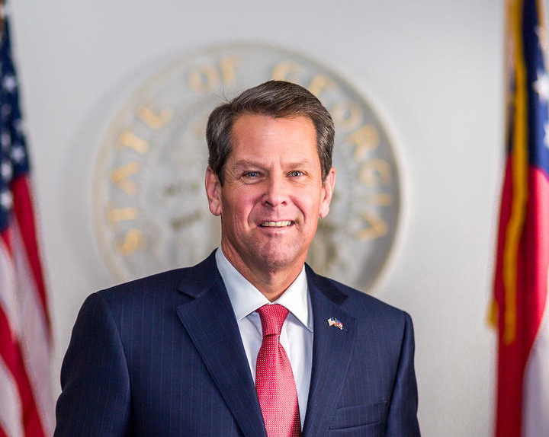
Summary of Governor’s Recommendations
 | AFY 2022 | FY 2023
Current Budget (State Funds) | $816,659,560 | $816,659,560
Statewide Adjustments (Common Changes) | $27,071,420 | $51,343,936
Workload Adjustments | $6,835,449 | $34,832,143
Other Adjustments | - | -
Total Adjustments | $33,906,869 | $86,176,079
Governor’s Recommended Budget (Includes Attached Entities) | $850,566,429 | $902,835,639
Office of the Commissioner
Notes:
Overall for DHS, the Governor has recommended:
An amended Fiscal Year 2022 budget of $850.5 million in state funds, AND
$902.8 million in state funds for Fiscal Year 2023.
This amounts to:
For Amended Fiscal Year 2022, an increase in expenditures of $33.9 million; AND
For Fiscal Year 2023, an increase in expenditures of $86.1 million
.

Slide 5
Governor’s Recommendations
State Fund Changes (Statewide Adjustments) | AFY 2022 | FY 2023
Increase funds for a $5,000 pay increase for all full-time, benefit eligible state employees to address agency recruitment and retention needs. | $27,071,420 | -
Increase funds to provide a $5,000 cost of living adjustment for all full-time, benefit eligible state employees effective July 1, 2022 to address agency recruitment and retention needs. | - | $37,559,190
Increase funds to allow eligible state employees to withdraw up to 40 hours of earned annual leave annually from their accrued leave balance. | - | $1,429,828
Reflect a change in the Employees' Retirement System employer contribution rate to fully fund the actuarial determined employer contribution, provide for a cost of living adjustment for retirees, increase the employer 401(k) match for GSEPS employees, and fund the employer share of accrued forfeited leave for retiring employees. | - | $12,640,358
Office of the Commissioner
2/16/2022

Slide 6
Governor’s Recommendations
State Fund Changes (Statewide Adjustments) | AFY 2022 | FY 2023
Reflect an adjustment to agency premiums for Department of Administrative Services administered insurance programs. | - | $77,188
Increase funds to reflect an adjustment in the Federal Medical Assistance Percentage (FMAP) from 66.85% to 66.02%. | - | $1,024,459
Reflect a change in the Teachers' Retirement System actuarially determined contribution from 19.81% to 19.98%. | - | $462
Reflect an adjustment in TeamWorks billings. | - | ($1,394,608)
Increase funds to reflect an adjustment in the enhanced Federal Medical Assistance Percentage (e-FMAP) from 76.80% to 76.21%. | - | $7,059
Total State Funds | $27,071,420 | $51,343,936
Office of the Commissioner
2/16/2022

Slide 7
Governor’s Recommendations
State Fund Changes (Workload Adjustments) | AFY 2022 | FY 2023
Increase funds for the Integrated Eligibility System costs for the implementation of the Patients First Act (2019 Session). [Departmental Administration] | $4,016,595 | -
Increase funds for the American Rescue Plan state match requirement for meals, supportive services, family caregiver support, and preventive health services to the Area Agencies on Aging. (Total Funds: $40,712,367) [Elder Community Living Services] | $2,718,854 | -
Total State Funds | $6,735,449
Office of the Commissioner
2/16/2022

Slide 8
Governor’s Recommendations
State Fund Changes (Workload Adjustments) | AFY 2022 | FY 2023
Provide funds for a community action team pilot program to address children who are in, or are at risk of entering, foster care. [Child Welfare Services] | - | $1,500,000
Provide funds for an autism recognition pilot program in Region 12. [Child Welfare Services] | - | $451,978
Provide funds for autism respite care. [Child Welfare Services] | - | $1,000,000
Provide funds for a 10% provider rate increase for Child Caring Institutions, Child Placing Agencies, foster parents, and relative caregivers. (Total Funds: $31,487,817) [Out-of-Home Care] | - | $27,810,584
Total State Funds |  | $30,762,562
Office of the Commissioner
2/16/2022

Slide 9
Governor’s Recommendations
State Fund Changes (Other Adjustments) | AFY 2022 | FY 2023
Dedicate $1,100,533 in state general funds as State Children's Trust Funds to reflect FY 2021 collections of marriage and divorce filing fees pursuant to HB 511 (2021 Session). [Child Abuse Neglect and Prevention] | - | Yes
Utilize $6,700,000 in existing funds to improve the continuum of care including preventative and therapeutic services, in addition to addressing youth with complex needs. [Out-of-Home Care] | - | Yes
Office of the Commissioner
2/16/2022
Notes:
This slides reflects to “Yes” line items we have in Fiscal Year 2023.
The first Yes item relates to………
The last “Yes” item relates to………

Slide 10
Entities Attached for Administrative Purposes
Office of the Commissioner
2/16/2022
Notes:
The Council on Aging, Family Connection Partnership, Georgia Vocational Rehabilitation Agency, and Safe Harbor for Sexually Exploited Children Fund Commission are attached to DHS for administrative purposes only.

Slide 11
Governor’s Recommendations
Entities Attached for Administrative Purposes | AFY 2022 | FY 2023
Council on Aging Debra L. Stokes debra.stokes@gcoa.ga.gov 404.434.1380 | $18,176 | $38,610
Family Connection Gaye Smith gaye@gafcp.org 404.527.7394 | - | -
Georgia Vocational Chris Wells Rehabilitation Agency chris.wells@gvs.ga.gov 404.656.7952 | $2,050,532 | $8,018,550
Safe Harbor for Sexually Candice L. Broce Exploited Children Fund candice.broce@dhs.ga.gov Commission 678.346.8900 | - | ($240,419)
Total State Funds | $2,068,708 | $7,816,741
Office of the Commissioner
2/16/2022
Notes:
The Governor has not recommended any changes to the budgets for the Family Connection Partnership.
These are the Governor’s recommendations for the entities that are administratively attached to DHS.
This slide provides contact information for leadership of the attached entities.
_______________________________________________
NOTES:
Debra L. Stokes, executive director of the Council on Aging
Gaye Smith, executive director of the Family Connection Partnership
Chris Smith, executive director of GVRA, AND
Division of Family and Children Services Director Candice Broce, who chairs Safe Harbor for Sexually Exploited Children Fund Commission

Slide 12
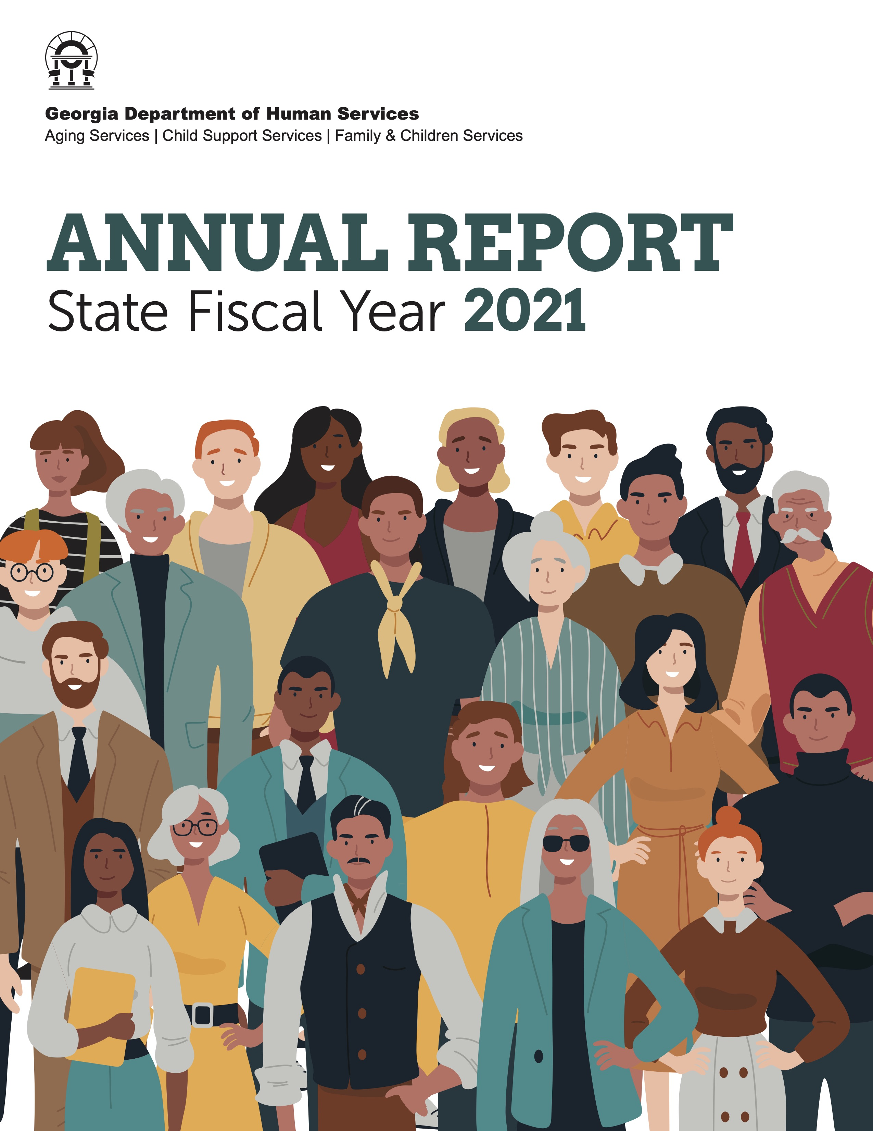
Questions
R. Demetrius Taylor
Deputy Commissioner, Finance
r.demetrius.taylor@dhs.ga.gov
Cliff O’Connor
Assistant Deputy Commissioner, Finance
clifford.oconnor@dhs.ga.gov
To view the Department’s Annual Report for Fiscal Year 2021, visit dhs.ga.gov.
Office of the Commissioner
2/16/2022
Notes:
That concludes the Governor’s recommendations for the Department of Human Services Amended Fiscal Year 2022 and Fiscal Year 2023 budgets.
I am happy to answer any questions you may have at this time. (PAUSE FOR QUESTIONS)
Before I leave, I want to bring to your attention that detailed information on the Department’s performance and accomplishments for SFY 2021 is available in our SFY 2021 Annual Report. A link to the report was sent to all members of the General Assembly on Dec. 29, 2020. However, you may also locate the report on our website at dhs.georgia.gov.
Again, thank you for this opportunity. Please do not hesitate to contact me with any additional questions you may have.

