Slide 1
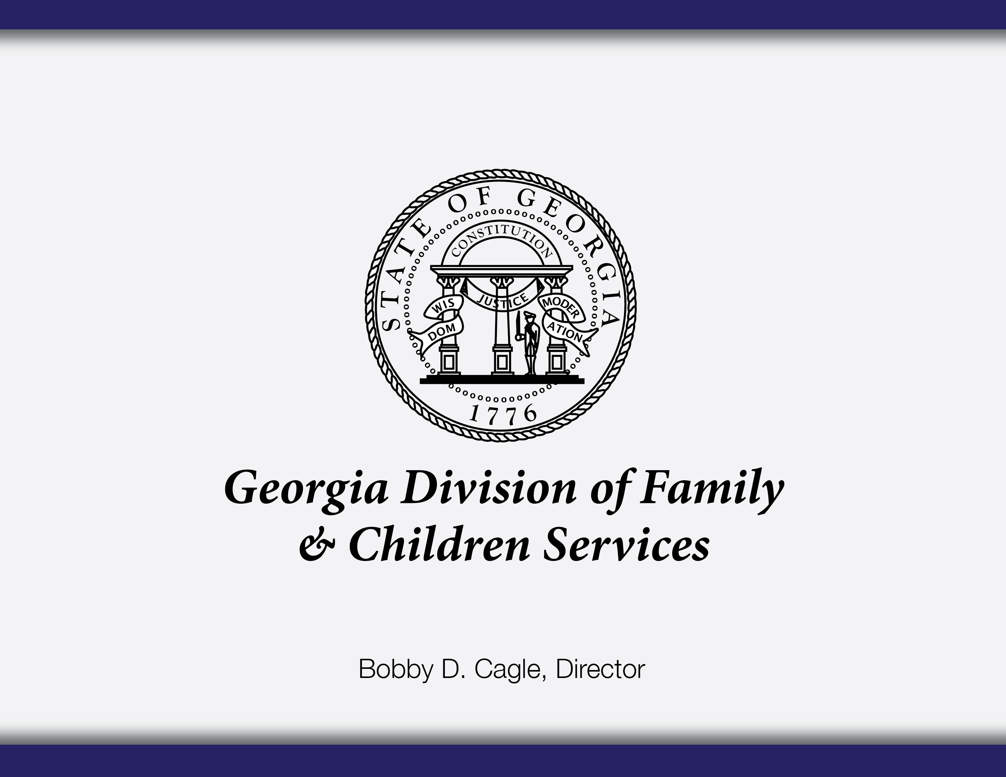

Slide 2
Vision and Mission Statements | Core Values
Vision
Safe Children. Strengthened Families. Stronger Communities
Mission
We commit to the safety of Georgia’s children in the decisions we make and the actions we take. We strengthen families toward independence and build stronger communities through caring, effective, and responsive service.
Guiding Principles
As the Division of Family and Children Services, we…..
    Commit to the safety of our children in the decisions we make and the actions we take
    Strengthen and support families on their path toward independence
    Embrace a servant’s heart with compassion
    Provide caring, responsive, and effective services
    Listen and respond to our constituents, communities, and each other
    Collaborate with our communities to create systems of support
    Strive to make lives better for the children and families we serve
    Build a competent, efficient workforce that never stops learning and growing

Slide 3
Regional Structure
Region 1: Catoosa, Chattooga, Cherokee, Dade, Fannin, Gilmer, Gordon, Murray, Pickens, Walker, Whitfield
Region 2: Banks, Dawson, Forsyth, Franklin, Habersham, Hall, Hart, Lumpkin, Rabun, Stephens, Towns, Union, White
Region 3: Bartow, Douglas, Floyd, Haralson, Paulding, Polk
Region 4: Butts, Carroll, Coweta, Fayette, Heard, Henry, Lamar, Meriwether, Pike, Spalding, Troup, Upson
Region 5: Barrow, Clarke, Elbert, Greene, Jackson, Jasper, Madison, Morgan, Newton, Oconee, Oglethorpe, Rockdale, Walton
Region 6: Baldwin, Bibb, Crawford, Houston, Jones, Monroe, Peach, Putnam, Twiggs, Wilkinson
Region 7: Burke, Columbia, Glascock, Hancock, Jefferson, Jenkins, Lincoln, McDuffie, Richmond, Screven, Taliaferro, Warren, Washington, Wilkes
Region 8: Chattahoochee, Clay, Crisp, Dooly, Harris, Macon, Marion, Muscogee, Quitman, Randolph, Schley, Stewart, Sumter, Talbot, Taylor, Webster
Region 9: Appling, Bleckley, Candler, Dodge, Emanuel, Evans, Jeff Davis, Johnson, Laurens, Montgomery, Pulaski, Tattnall, Telfair, Toombs, Treutlen, Wayne, Wheeler, Wilcox
Region 10: Baker, Calhoun, Colquitt, Decatur, Dougherty, Early, Grady, Lee, Miller, Mitchell, Seminole, Terrell, Thomas, Worth
Region 11: Atkinson, Bacon, Ben Hill, Berrien, Brantley, Brooks, Charlton, Clinch, Coffee, Cook, Echols, Irwin, Lanier, Lowndes, Pierce, Tift, Turner, Ware
Region 12: Bryan, Bulloch, Camden, Chatham, Effingham, Glynn, Liberty, Long, McIntosh
Region 13: Clayton, Cobb, Gwinnett
Region 14: DeKalb, Fulton
5

Slide 4
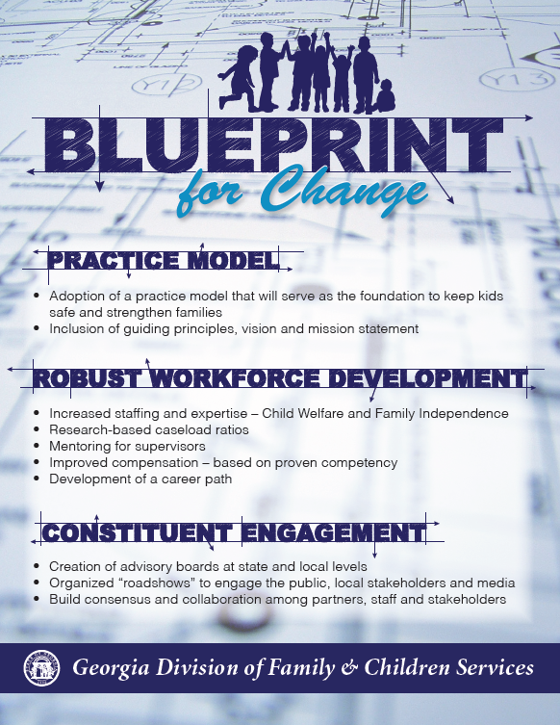
6

Slide 5
Practice Model
Georgia One (Old Model) | One Caseworker, One Family (New Model)
Virtual Service | Local Service
Virtual Supervision | Geographic Supervision
Task-Based Work Assignments | Accountable for entire case
Call Center focused | County based service
Statewide work sharing | Individual SUCCESS caseloads
No one person responsible for case | Each Customer will have a local Case Manager

Slide 6
QC Standard of Promptness
2011-2015

Slide 7
QC Error Rates FFY2011-2015
*FFY 2015 data represents a partial year (October 2014 - June 2015)

Slide 8
OFI Customer Contact Center
Interviews are no longer being handled by the Customer Change Center Agents.
Customer Contact Center Agents now focused on:
Changes
General Inquiry Calls
IVR Self-Service Options are still available

Slide 9
OFI Customer Contact Center
Customers are given their caseworker’s direct phone line.
IVR Routing to Caseworker – customers that call the 877 number are automatically routed to their caseworker for an interview if they have an appointment.
Robo-Calls. Outbound calls remind customers of their appointment times. This helps the agency with timeliness and provides customers with a 1-2 day notification

Slide 10
Call Center Wait Times

Slide 11
  QUESTIONS
  AND
  COMMENTS
6

