Slide 1
Division of Family and Children Services
Office of Child Welfare for the DHS Board Meeting
Virginia Pryor
Deputy Division Director Child Welfare
Safe Children. Strengthened Families. Stronger Communities
Division of Family & Children Services

Slide 3
THE BLUEPRINT FOR CHANGE
Robust Workforce Development
Increased staffing and expertise – Child Welfare and Family Independence
Research-based caseload ratios
Mentoring for supervisors
Improved compensation – based on proven competency
Development of a career path
3

Slide 4
THE BLUEPRINT FOR CHANGE
Practice Model
Adoption of a practice model that will serve as the foundation to keep kids safe and strengthen families
Inclusion of guiding principles, vision and mission statement
4

Slide 5
THE BLUEPRINT FOR CHANGE
Constituent Engagement
Creation of advisory boards at state, regional and local levels
Organized “roadshows” to engage the public, local stakeholders and media
Build consensus and collaboration among partners, staff, and stakeholders
Division Branding Initiative
5

Slide 6
THE BLUEPRINT FOR CHANGE
Constituent Engagement
Branding initiative - #iamtheblueprint
Purpose: to shape and define the child welfare narrative both internally and externally
Branding the Blueprint through storytelling – the “why”
Video shoots with Division staff and WE Creative Services
Future opportunities for providers and stakeholders
6

Slide 7
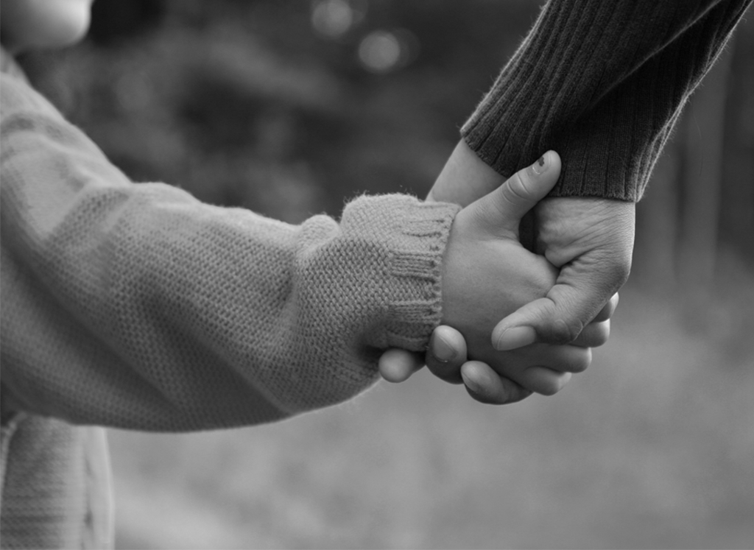
BRANDING THE BLUEPRINT
Why Brand?
COMMON TRAITS. |  | DFCS RATIONALE.
Streamline your identity Avoid the clutter of too many mixed messages, logos, communication materials Revitalize brand identity Our identity does not represent us any longer Create an integrated system Our visual materials do not look the same To give your brand a story A change to the positioning and brand promise of an organization. Bad Reputation Outdated Image Further development of Corporate Identity Changing brand portfolio Your brand is boring A change in company strategy or name |  | To create a unifying link between Child Welfare and OFI that other partners can connect too - possibly a connected vision around serving children and families (the blueprint for change - the journey toward a state of hope) To tell a positive story about our work To have a strong visual presence that connects to our story To shape and define our own narrative instead of having others shape and define it for us Use the rebrand effort as a catalyst to improve practice, positively shape culture, strengthen and expand the workforce and strengthen and expand our partnerships
7

Slide 8
One Voice, One Organization, One Message
UNIFIED
BRAND
Child Welfare
OFI
OUR AUDIENCE
Internal: Line Staff, Managers & Leadership
External: Foster Parents, Children & Youth, Families, Providers and Communities
BIG IDEA:
THE
FOR CHANGE
BLUEPRINT
PROMISE
EXPERIENCE
Be the brand WE want to be: Mission, Vision & Guiding Principles
The 3 Pillars:
Robust Workforce Development
Practice Model
Constituent Engagement
BRAND STORY
(Humanizing the Message)
OBJECTIVES
STRATEGY
#IAMTHE BLUEPRINT
The Universal Brand Message
Behind every brand there’s a story.
DFCS - The Brand
Change the image and perception of the brand thru positive storytelling
Positioning
Culture & Operations
Brand Plan
Communication
Platforms
Innovation
8

Slide 9
9

Slide 10
10

Slide 11
11

Slide 12
23
12

Slide 13
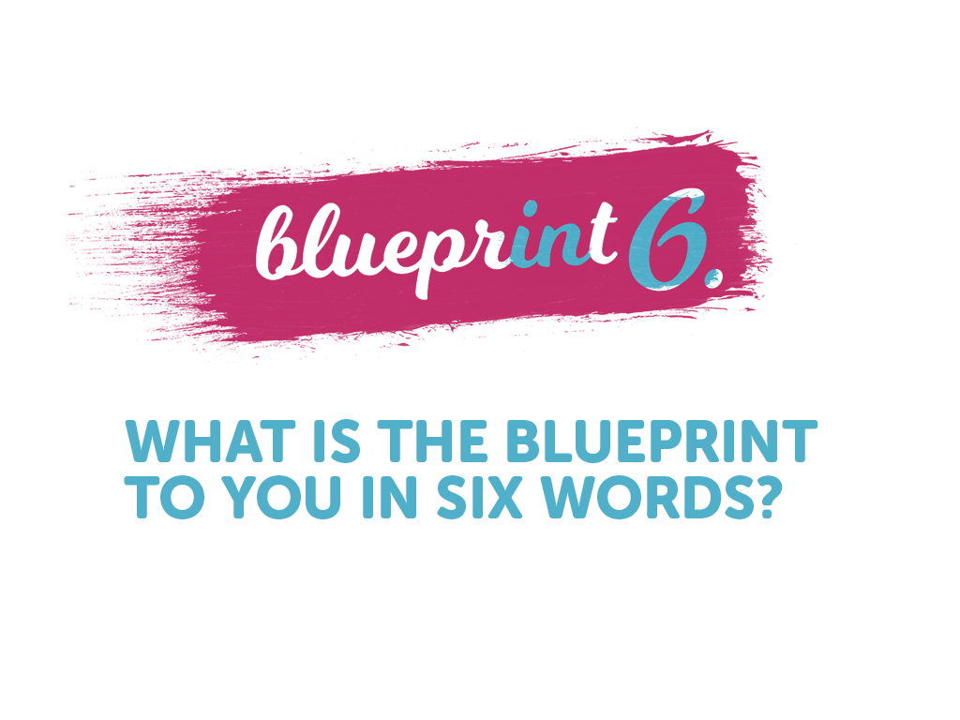
13

Slide 14
14

Slide 15
15

Slide 16
16

Slide 17
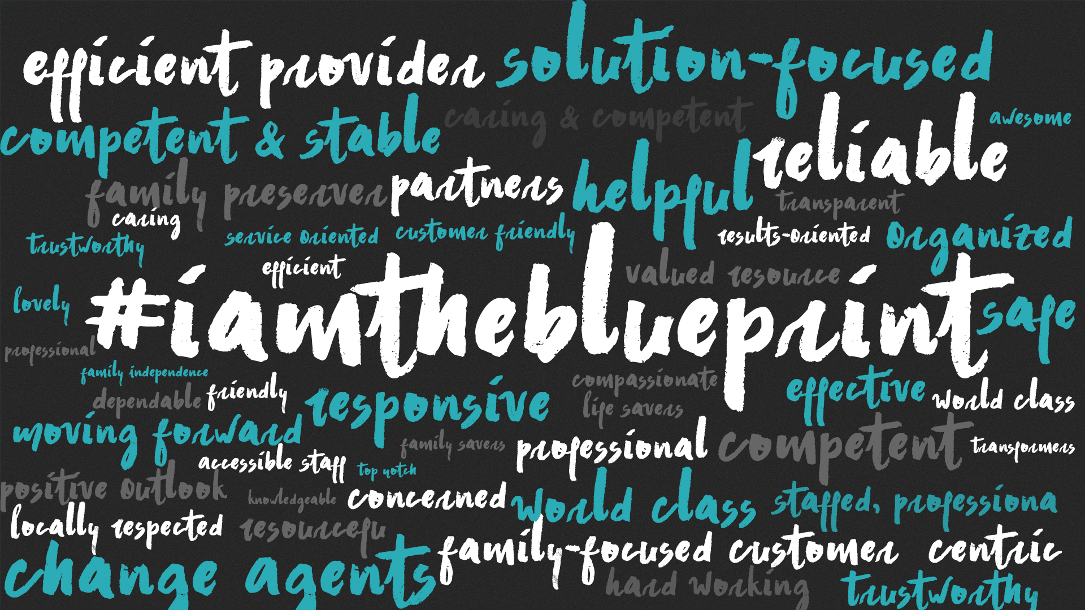
17

Slide 18
Questions?
18

