Slide 1


Slide 2
Vision and Mission Statements | Core Values
Vision
Safe Children. Strengthened Families. Stronger Communities
Mission
We commit to the safety of Georgia’s children in the decisions we make and the actions we take. We strengthen families toward independence and build stronger communities through caring, effective, and responsive service.
Guiding Principles
As the Division of Family and Children Services, we…..
    Commit to the safety of our children in the decisions we make and the actions we take
    Strengthen and support families on their path toward independence
    Embrace a servant’s heart with compassion
    Provide caring, responsive, and effective services
    Listen and respond to our constituents, communities, and each other
    Collaborate with our communities to create systems of support
    Strive to make lives better for the children and families we serve
    Build a competent, efficient workforce that never stops learning and growing

Slide 3
Region 1: Catoosa, Chattooga, Cherokee, Dade, Fannin, Gilmer, Gordon, Murray, Pickens, Walker, Whitfield
Region 2: Banks, Dawson, Forsyth, Franklin, Habersham, Hall, Hart, Lumpkin, Rabun, Stephens, Towns, Union, White
Region 3: Bartow, Douglas, Floyd, Haralson, Paulding, Polk
Region 4: Butts, Carroll, Coweta, Fayette, Heard, Henry, Lamar, Meriwether, Pike, Spalding, Troup, Upson
Region 5: Barrow, Clarke, Elbert, Greene, Jackson, Jasper, Madison, Morgan, Newton, Oconee, Oglethorpe, Rockdale, Walton
Region 6: Baldwin, Bibb, Crawford, Houston, Jones, Monroe, Peach, Putnam, Twiggs, Wilkinson
Region 7: Burke, Columbia, Glascock, Hancock, Jefferson, Jenkins, Lincoln, McDuffie, Richmond, Screven, Taliaferro, Warren, Washington, Wilkes
Region 8: Chattahoochee, Clay, Crisp, Dooly, Harris, Macon, Marion, Muscogee, Quitman, Randolph, Schley, Stewart, Sumter, Talbot, Taylor, Webster
Region 9: Appling, Bleckley, Candler, Dodge, Emanuel, Evans, Jeff Davis, Johnson, Laurens, Montgomery, Pulaski, Tattnall, Telfair, Toombs, Treutlen, Wayne, Wheeler, Wilcox
Region 10: Baker, Calhoun, Colquitt, Decatur, Dougherty, Early, Grady, Lee, Miller, Mitchell, Seminole, Terrell, Thomas, Worth
Region 11: Atkinson, Bacon, Ben Hill, Berrien, Brantley, Brooks, Charlton, Clinch, Coffee, Cook, Echols, Irwin, Lanier, Lowndes, Pierce, Tift, Turner, Ware
Region 12: Bryan, Bulloch, Camden, Chatham, Effingham, Glynn, Liberty, Long, McIntosh
Region 13: Clayton, Cobb, Gwinnett
Region 14: DeKalb, Fulton
Regional Structure

Slide 4
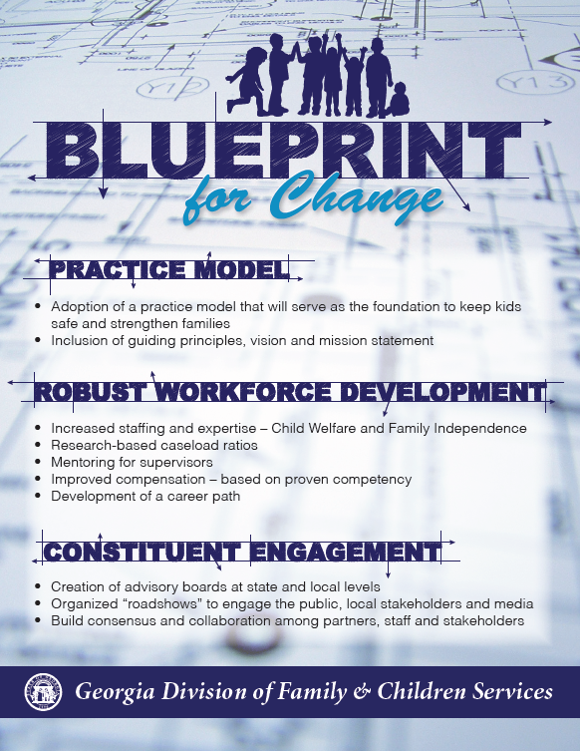

Slide 5
Number of Food Stamp Cases at or below the
125% Poverty Level
Note: October 2015 data is not available at the time of completion of the report

Slide 6
Number of Family Medicaid and
Aged Blind Disabled (ABD) Medicaid

Slide 7
Total Number of TANF Recipients

Slide 8
Total Number of Childcare Applications Received

Slide 9
OFI Customer Contact Center
Agents now fully focused on reported changes and general inquiry calls
Effective Monday, 12/7/15, CCC agents will be available from 7:30 am – 2 pm
Implemented Robo-Calls to remind customer of upcoming interviews. This has been well received and appears to be effective.
Self-Service option has been highly effective in reducing calls and allowing customer to access their information

Slide 10
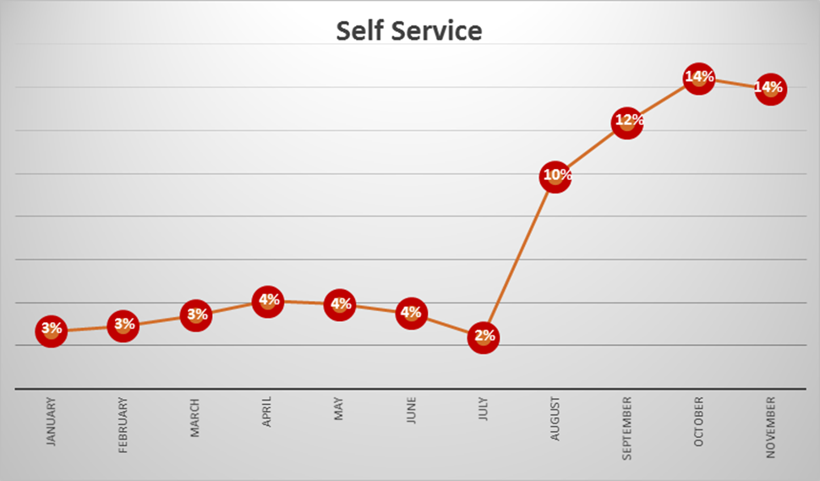
CCC Self Service Percentages
Percentage of customers who utilize the self service option

Slide 11
Call Center Wait Times - November 2015
Total calls offered for the month of November = 182,427
Total calls answered = 138,100 (On average 40% of the calls that were answered were accepted by an agent within 0-15 minutes)
Total calls abandoned = 44,327 (On average 85% of the callers who abandoned did so within 0-15 minutes)

Slide 12
Technology Improvements:
Document Imaging System (DIS)
DIS is our Electronic Repository for our paper files – both Applications and Verification
Previously, our workers would have to search through DIS for incoming verification each day. This was tedious and time consuming
In September, staff began receiving email notifications when documents/verification was uploaded to their caseload.
As of 11/20/15: 24,297 emails had been sent to alert staff that case information had arrived for their caseload.

Slide 13
  QUESTIONS
  AND
  COMMENTS

