Slide 1



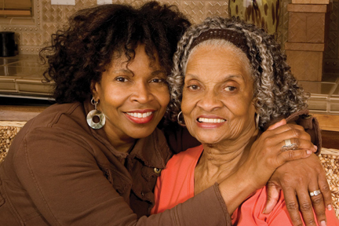

DHS Faith and Community
Alliance
Presenter: Robert Nibbs
Director, Strategic Planning & Execution
Rev. Dr. Willie Myles, Statewide Coordinator
Presentation to: DHS Board
Date: June 18, 2015
Georgia Department of Human Services
1

Slide 2
Vision, Mission and Core Values
Vision
Stronger Families for a Stronger Georgia.
Mission
Strengthen Georgia by providing Individuals and Families access to services that promote self-sufficiency, independence, and protect Georgia's vulnerable children and adults.
Core Values
Provide access to resources that offer support and empower Georgians and their families.
Deliver services professionally and treat all clients with dignity and respect. Manage business operations effectively and efficiently by aligning resources across the agency.
Promote accountability, transparency and quality in all services we deliver and programs we administer.
Develop our employees at all levels of the agency.
2
Notes:
2

Slide 3
DHS Strategic Approach … “we can not do it alone”
The Faith and Community Alliance is a non-denominational, interfaith group of faith community members who meet and advocate for Georgia's vulnerable children and families. The common ground they all share is compassion, and a desire to improve the community. The strategy includes three stages of development:
Phase I Education Awareness
Phase II Training
Phase III Community Empowerment
4

Slide 4

New Logo

Slide 5
Faith and Community Alliance Strategy
The State is divided into 15 regions.
All regions has a Faith Community Leader serving in the capacity of Chair and Co-Chair except regions 2,4, 9,11,13. We anticipate having these positions filled by June 30, 2015.
Ten regions have identified outcomes for each of the following committees that they working towards:
Vulnerable Children and Families
Parental
Elderly Care
Prison Re-Entry Services
Communications
Fatherhood/Child Support
Mental Health
6

Slide 6
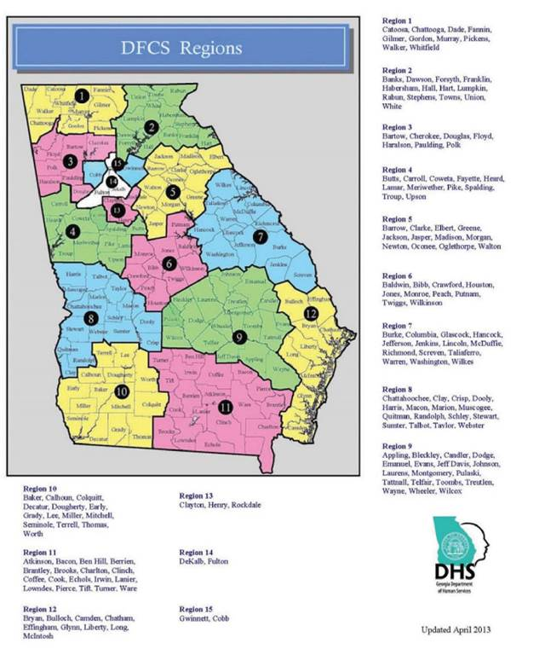
Statewide Regions
7

Slide 7
Georgia Department of Children and Families Initiative
The department has embarked upon an 11 County Statewide tour. Bobby Cagle, Director, Georgia’s Division of Family and Children Services, and Stephanie Blank, Chairwoman of the Governor’s Child Welfare Reform Council, goal is to discuss the impact that the of child welfare reform recommendations will have statewide. They have requested the Faith and Community Alliance to accompany them on their 3 day tour for each county statewide.
8

Slide 8
Partners
United States Department of Health and Human Services Region IV
AARP
Statewide AAA
Emory Alzheimer's Association
Division of Family and Children Services
Governor’s Office on Transition-Reentry and Support
Georgia Department of Juvenile Justice
DHS Fatherhood Programs
Emergency Preparedness Disability Liaison-Laura George
Atlanta Community Food Bank
Tdeferiamedia
DHS Fatherhood Program
NAMI
135 Churches
13 Ministerial Associations
100’s of profit and not for profit groups

Slide 9
Questions/Comments
???

