Slide 1
Georgia Integrated Eligibility System Department of Human Services Presentation
August 24, 2016
Shawn Ryan
Director, Integrated Eligibility System

Slide 2






What is IES?
One-stop shop for:
2

Slide 3

Legacy Systems
SUCCESS
(TANF, SNAP and Medicaid Eligibility)
COMPASS
(Citizen-Centric Platform to Apply for Benefits and Monitor Personal Account)
3

Slide 4








IES Governance Council
DHS
DCH
DECAL
DPH
DFCS
GTA
OPB
Office of the Governor
4

Slide 5
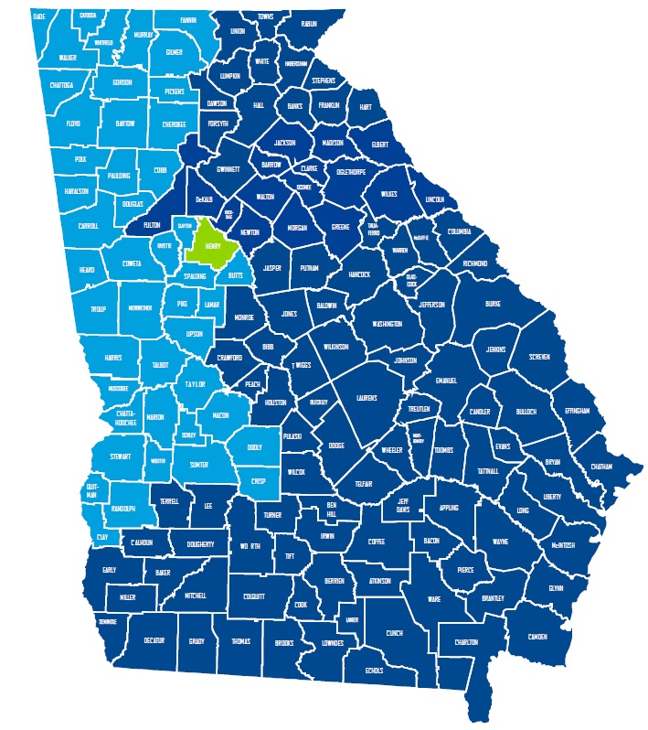
IES
Roll Out Waves
GREEN – Pilot
LIGHT BLUE – Wave 1
DARK BLUE – Wave 2
5

Slide 6



Where are we right now?
6

Slide 7

Security
Goal: Receive ATC
Needed: Enterprise Security Controls,
Third Party Assessment,
POAM
Completed: Controls and Assessment
In Flight:
POAM
7

Slide 8

Core System Integration Testing (SIT) is complete
8

Slide 9
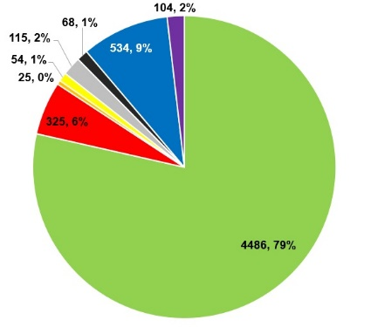
Overall IES Project Testing
User Acceptance Testing (UAT) is nearing completion
5,650 Total Scripts
GREEN – passed, RED – failed, BLUE – to be tested, YELLOW – testing in progress, PURPLE – to be written, ORANGE – paused, GREY – blocked, BLACK – deferred
9

Slide 10

Trading Partner Testing and Production Connectivity
27 Trading Partners and
36 Interfaces for Pilot
All require:
Scoping
Scheduling
Initial Testing Execution
Completion of Test and Re-Test
10

Slide 11
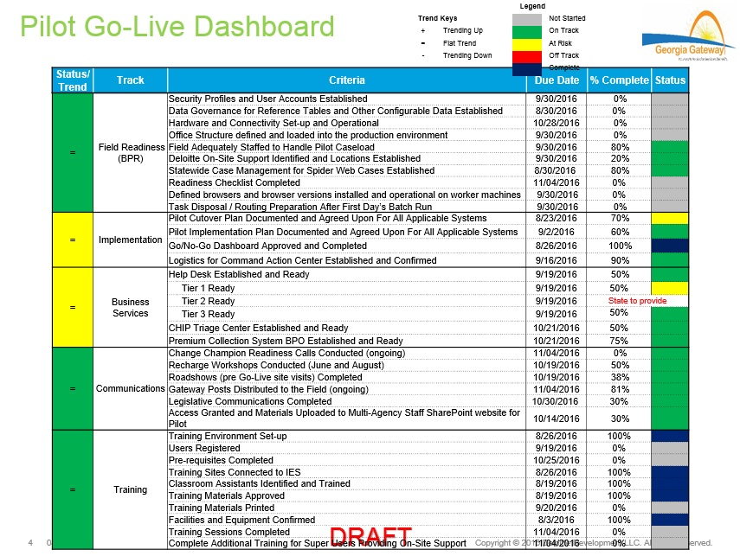
Moving to Implementation
11

Slide 12
Questions
???
12

