Slide 1
Youth Empowerment Series
Update
Kristyn Cherry, DHS Fellow
Notes:
Explain fellowship – Support the Commissioner in communicating with other agencies and offices as well as facilitate a welcoming atmosphere to those
meeting with the Commissioner and senior leaders.
Modeled after fellowship program at the Governor’s office
Full time paid position
This position is for one (1) year with potential for one (1) year renewal.
Responsibilities:
b) Lead and/or assist with various projects as needed.
c) Develop and implement the Commissioner’s Youth Advisory Board.
d) Respond to a variety of requests in person, by phone or in writing. Initiate or assist in the development of written responses as needed.
h) Prepare and edit correspondence, communications, presentations and other documents.

Slide 2
Overview
DHS Youth Empowerment Series (YES) seeks to develop a generation of young people who are engaged in the needs of their communities and who are equipped to educate and recruit others to help us build Stronger Families for a Stronger Georgia.
Our mission: Support Georgia’s youth in personal and professional development by providing opportunities for growth, learning and community impact.
Our vision: Transforming Georgia’s families by empowering youth to be tomorrow’s leaders today.
Our goal: Empower youth by providing tools for leadership; engage in meaningful conversation with students that will help to shape policies to strengthen Georgia’s families; encourage youth to disseminate knowledge of DHS and its services back to their communities.
Office of the Commissioner
Notes:
Lead: I’m happy to be presenting – past several months have been working on this project and I’ve seen it go from ideas on paper to an actual program with excited participants

Slide 3
Structure
Meetups
Six Saturday meetups throughout the year in various parts of the state
Mentors
Be available for educational or professional advice
Share ideas and provide feedback
Service Project
Groups will work to create a service project for each DHS division.
Office of the Commissioner
Notes:
Meetups = meetings where we discuss important issues, collaborate for solutions, and have fun!
Mentors = DHS employees who add extra layer of interaction…smaller groups for those who operate more efficiently on a 1 to 1 basis
Service Project = throughout the year, will work to create and implement one service project for each division.
At our first meetup we brainstormed ideas, and students came up with GREAT suggestions so I’m excited to see what happens

Slide 4
Meetup Schedule
Date | Location | Time
Saturday, August 13 The kickoff | 450 Riverside Pkwy., Ste. 110 Rome, GA 30161 | 9 a.m. – 3 p.m.
Saturday, October 29 Connect | 761 Wheaton St. Savannah, GA 31401 | 9 a.m. – 4 p.m.
Saturday, January 21 Leading the way | 456 Oglethorpe St. Macon, GA 31201-3278 | 9 a.m. – 4 p.m.
Saturday, February 18 Public policy | 206 Washington St. SW, Atlanta, GA 30334 | 9 a.m. – 4 p.m.
Saturday, April 8 Your future | 284 North Ave., Athens, GA 30601 | 9 a.m. – 4 p.m.
Saturday, June 10 The closing | Atlanta, GA TBD | 9 a.m. – 3 p.m.
Office of the Commissioner
Notes:
Each of our meetups has a theme to keep it cohesive
We have guest speakers slated to speak at each of these meetups
You all are more than welcome to attend should your schedule permit

Slide 5
Participant Selection
160 applications
75 interviews
51 participants
11 DFCS regions represented
Office of the Commissioner
Notes:
160 applications:
Incredible outreach
Solicited to students via flyers at offices
Direct mail to all high school and middle school counselors
informed leadership team about the program to spread the word via WOM
Letters to legislators
Facebook live events where I hosted Q&A for counselors and interested parties
Interviews
Students who were selected showed a clear passion for youth community involvement and collaboration
Looked for students who were both successful and had the potential to be successful in school
Not necessarily high achievrs or A+ students (not a requiremetn)
Studens were populations we serve
DFCS regions
Being the first year, this is a good representation and cross section of the population of Ga

Slide 6
Participant Representation
Office of the Commissioner

Slide 7
Rome, Ga. (8/13/16)
82% attendance rate
83 total attendees
98% want to attend the
next meetup in Savannah, Ga.
96% strongly agreed that they gained
knowledge at the meetup.
Office of the Commissioner
Notes:
Agenda
Icebreaker
Program overview
Service project
Careers
Vision boards

Slide 8
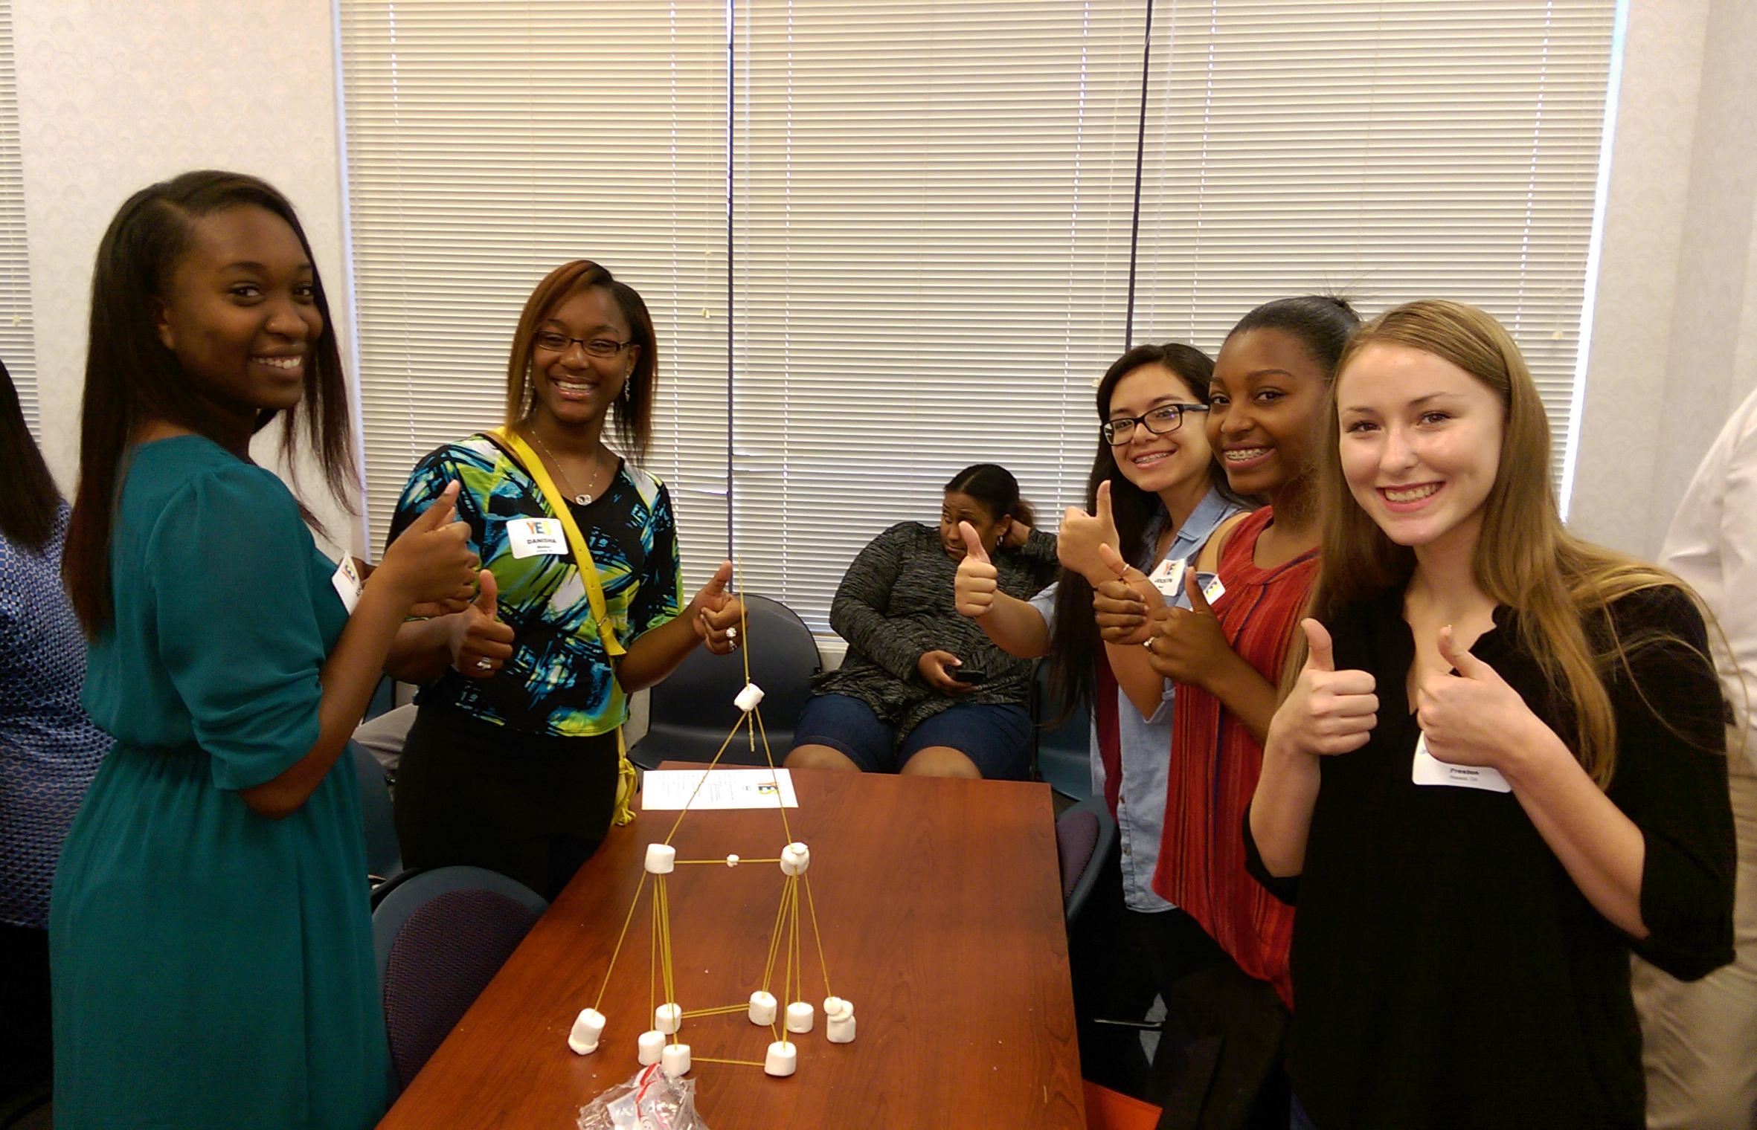
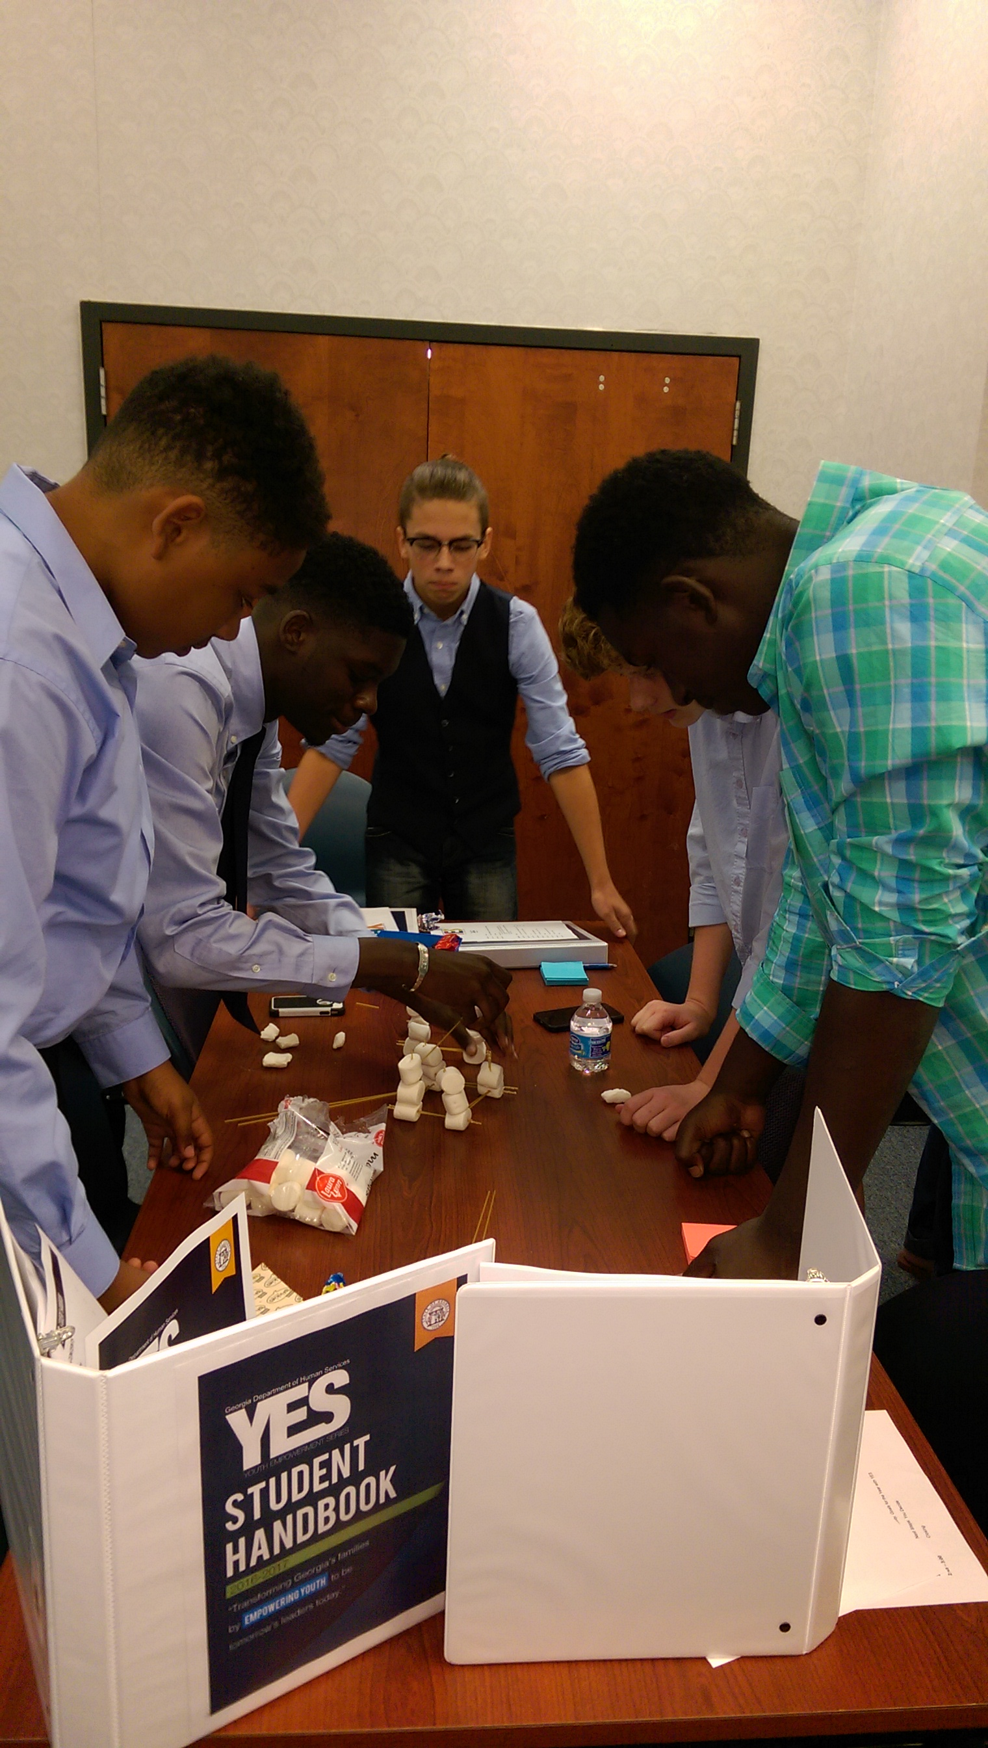
Rome, Ga. (8/13/16)
Office of the Commissioner

Slide 9
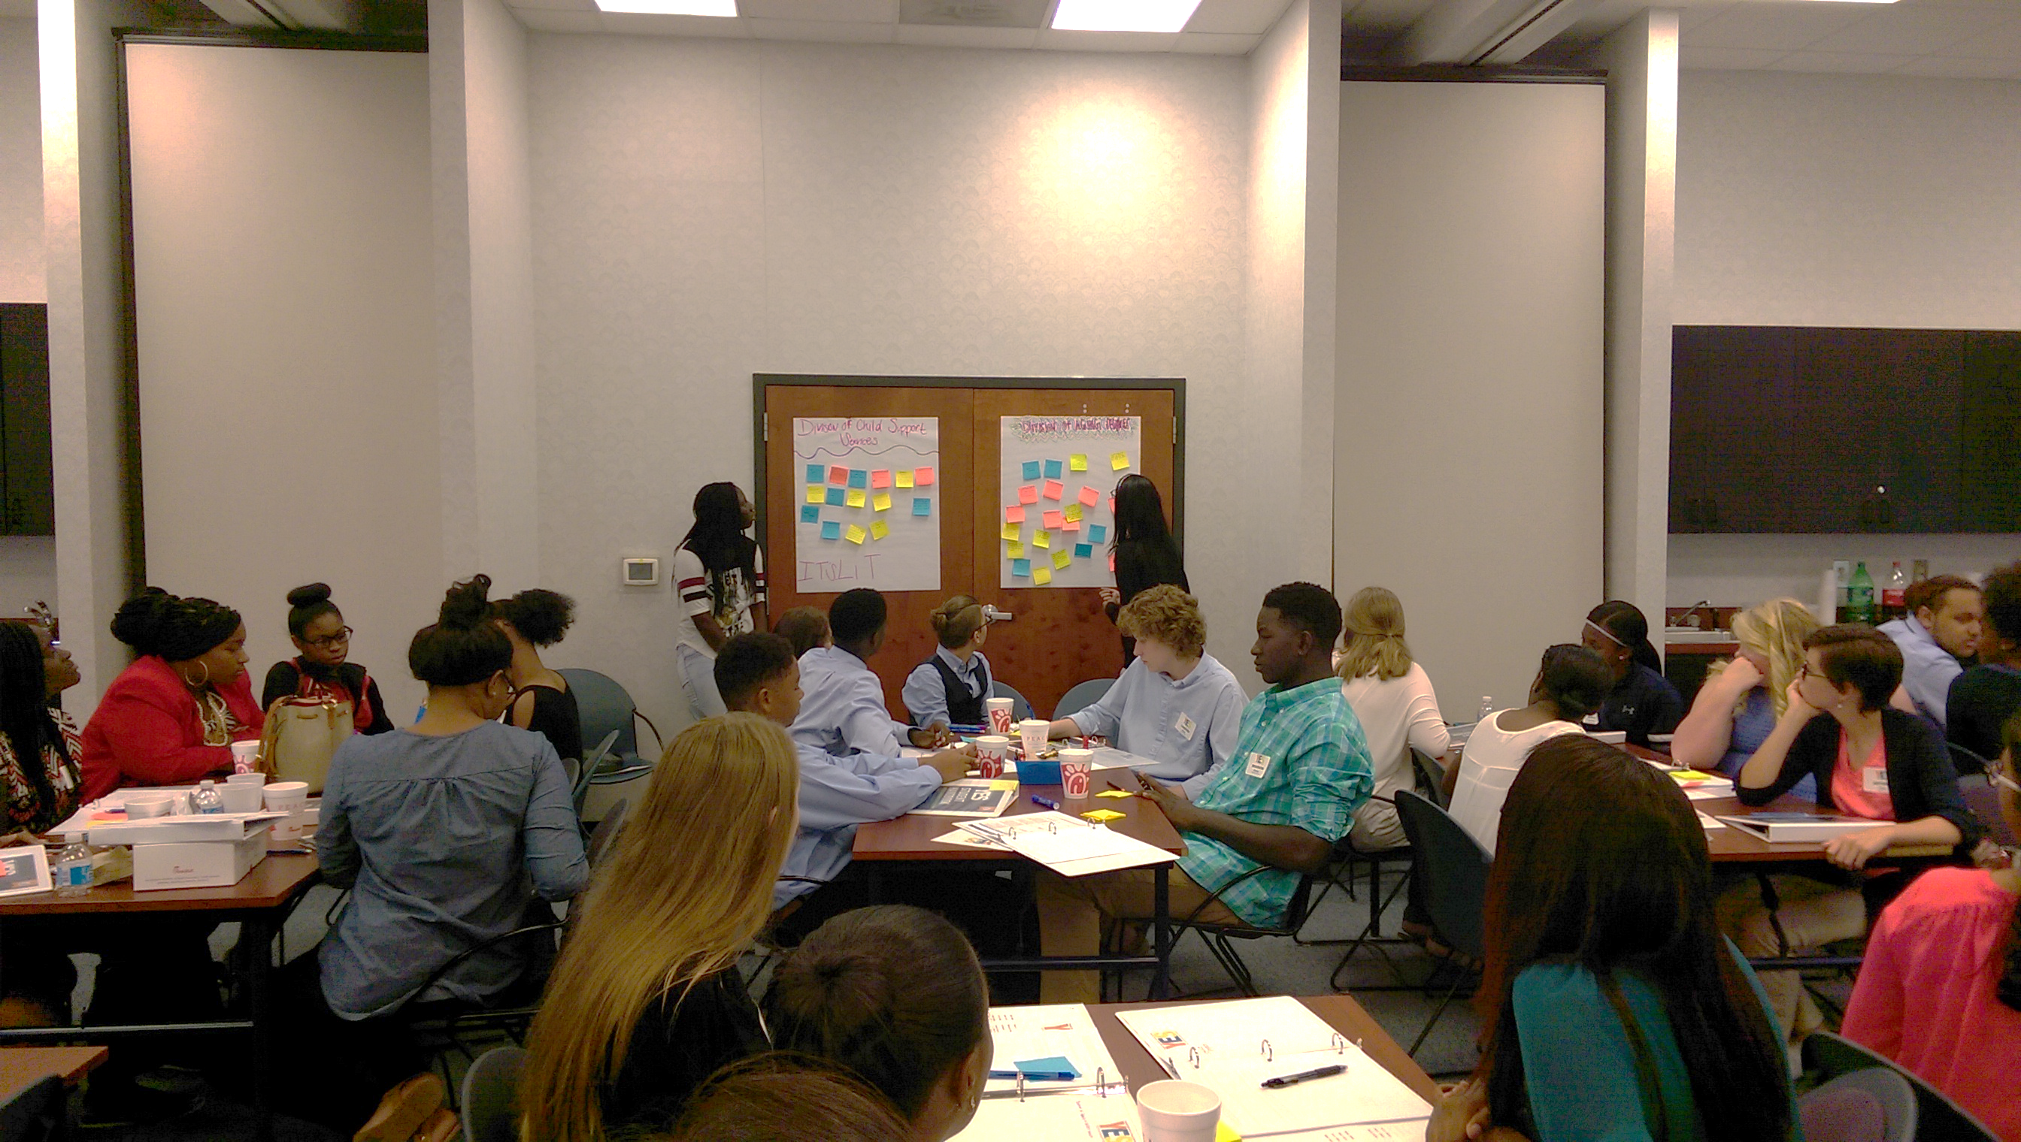
Rome, Ga. (8/13/16)
Office of the Commissioner
Notes:
About service project brainst

Slide 10
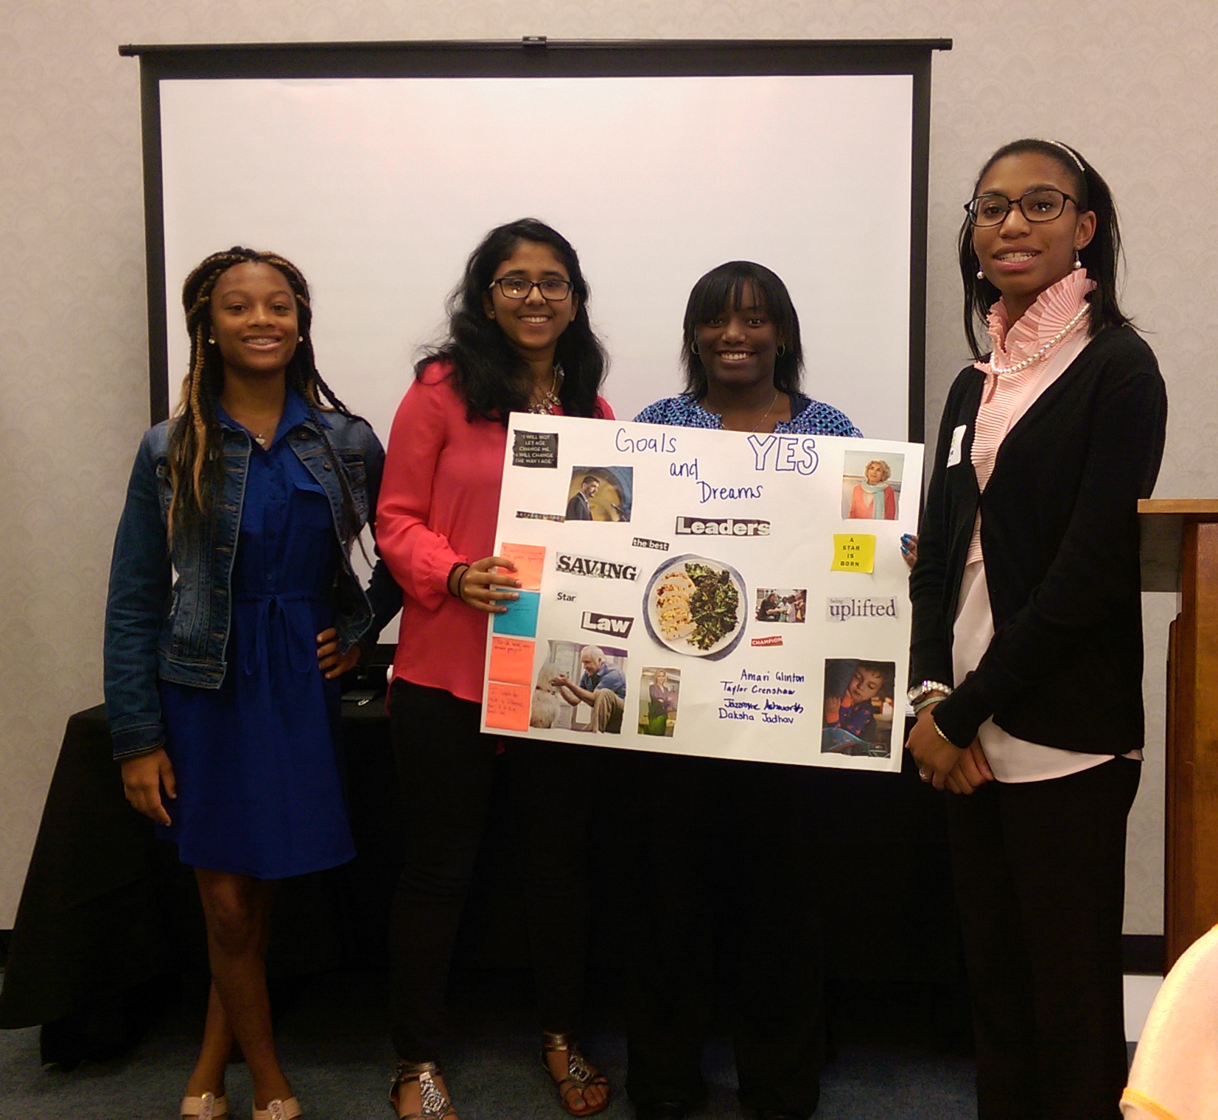
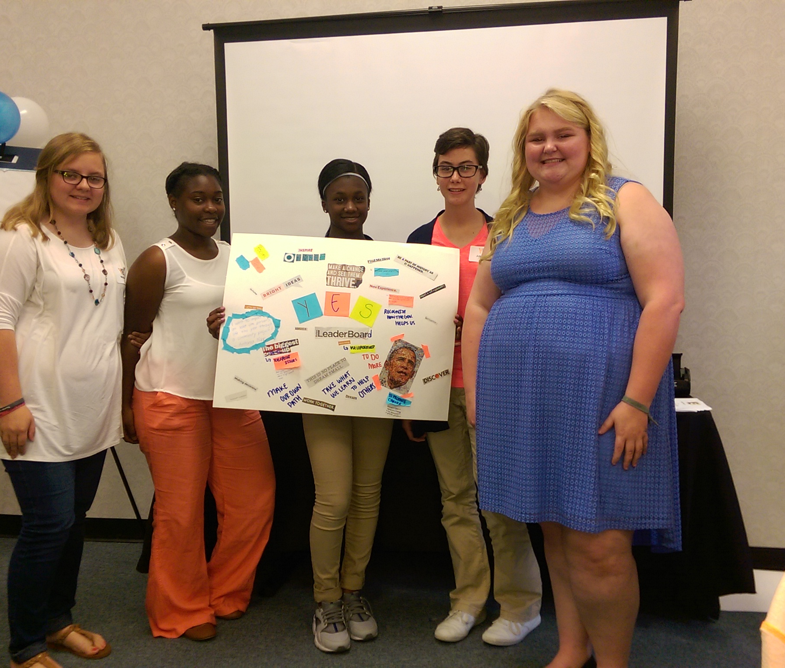
Rome, Ga. (8/13/16)
Office of the Commissioner
Notes:
See vision boards around the room

Slide 11
Questions
Office of the Commissioner

