Slide 1
Access and Visitation Program DHS Board Meeting – February 2022
John Hurst
Assistant Deputy Commissioner, Child Support Services
Ashlei Seals
Assistant Deputy Director of Administration, Child Support Services

Slide 2
Paternity Establishment Percentage (PEP)
Paternity Requirement – 90%
Georgia finished FFY 2020 at 84.11%
Increase to at least 86.11% required for FFY 2021
Georgia finished FFY 2021 at 89.85%
Increase to at least 90% required for FFY 2022
Office of Vital Records Impact
Voluntary Paternity Acknowledgement (PA)
In-Hospital PA programs
Outreach efforts continuing
45 CFR § 302.31
Division of Child Support Services

Slide 3
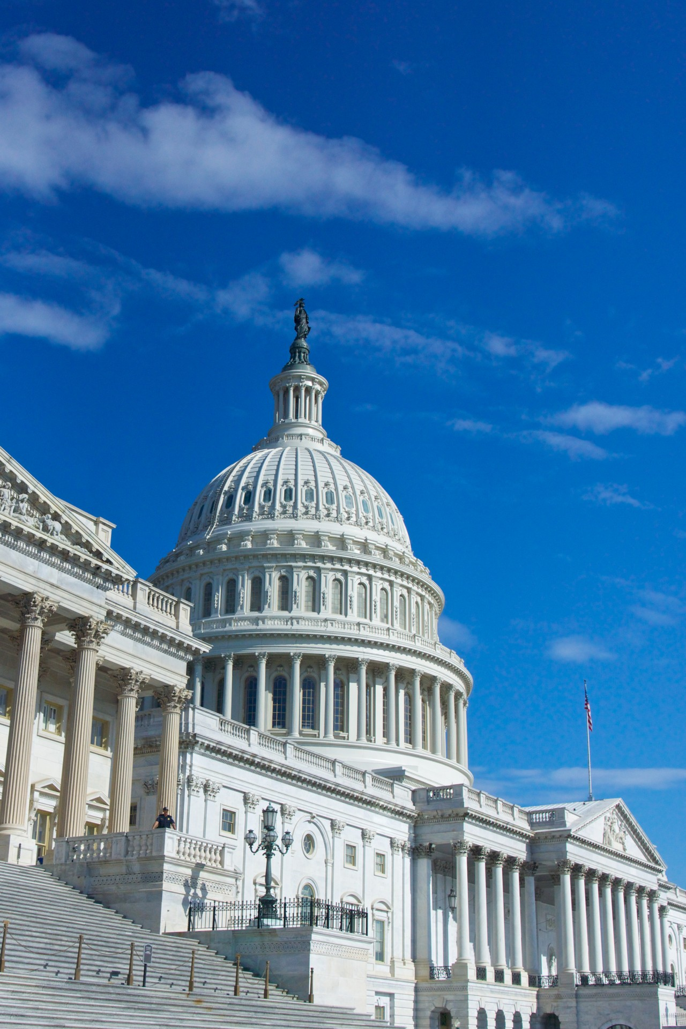
Paternity Establishment Performance Relief
NPRM published October 19, 2021
Provides targeted and time limited relief to states from penalties due to the National Health Emergency caused by COVID-19
Modifies Paternity Establishment Percentage threshold from 90% to 50% for Federal Fiscal Years (FFY) 2020 and 2021
Adverse findings of data reliability audits for state’s paternity establishment data will not result in a financial penalty
Consideration being given to include FFY 2022
Final approval of proposed rule pending
Division of Child Support Services

Slide 4
Access and Visitation Program DHS Board Meeting – February 2022
Ashlei Seals
Assistant Deputy Director of Administration, Child Support Services

Slide 5
DCSS Access and Visitation (AV)
Created in 1997
Federal grant from the U.S. Department of Health and Human Services, Office of Child Support Enforcement
Supports and facilitates noncustodial parents’ access to and visitation with their children
Referral-based program
Over $10 million distributed annually to all states who offer Access and Visitation services
Georgia received $338,606 for FFY 2022
Division of Child Support Services
Notes:
Referral-based program for parents interested in AV services who do not have a domestic violence history

Slide 6
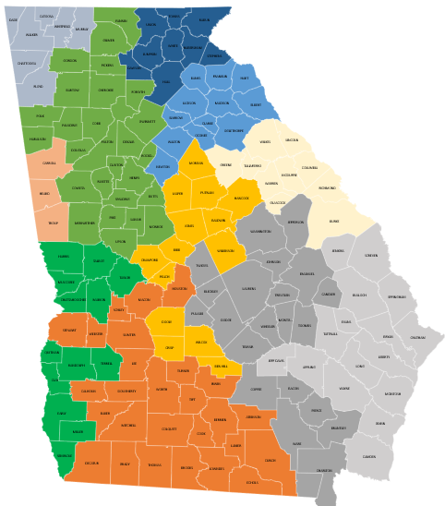
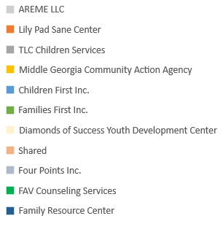
Services available statewide
AV has 10 contracted vendors who cover the entire state
Division of Child Support Services
Notes:
Note – Carroll, Heard, and Troup are not covered by a vendor contract but referrals for those counties are handled by Families First until a vendor closer to those counties can be identified.

Slide 7
FFY 21 Services Provided
Services are available for all parents in Georgia who have an active child support case
Individual Parent Education
2,198
Group Parent Education
276
Visitation Services
217
DCSS
Division of Child Support Services

Slide 8
Strategic Plan Goal
Increase the number of DCSS referrals to the Access and Visitation Program from 520 to 2,127 by September 30, 2024.
FFY 2021 increase in referrals was a result of:
Vendors transitioned to virtual meetings
Increased from 82 counties covered to 123 counties covered
Program awareness training provided to offices
Updated DCSS AV website page and online referral form
Reviewed reports monthly to identify offices with lower referrals
Followed up with parents who were referred but failed to enroll in the program
886 parents enrolled and received services
Parents who enrolled had a total of 1,141 children
Year | Target | Results
Baseline » 98
FFY 2020 | 520 | 655
FFY 2021 | 520 | 1,821
FFY 2022 | 1,647 | *591
*Total for October, November, December 2021
Division of Child Support Services

Slide 9
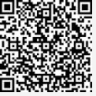
FFY 2021 Program Enhancements
Online referral form parents can access through the DCSS website, DCSS mobile app or by clicking on a QR code
Updated AV Brochure in English and Spanish
Online survey to gather feedback about quality of services
Statewide training to DCSS staff to promote the program
Dedicated phone line for questions about the program
Division of Child Support Services

Slide 10
Questions
John Hurst
Assistant Deputy Commissioner
Georgia Department of Human Services
Georgia Division of Child Support Services
Office phone: 404-463-0992
Email: John.Hurst@dhs.ga.gov
Ashlei Seals
Assistant Deputy Director of Administration
Georgia Department of Human Services
Georgia Division of Child Support Services
Office phone: 470-403-6061
Email: Ashlei.Seals@dhs.ga.gov
Division of Child Support Services

