Slide 1
General Meeting and Faith Community Training
Rev. Dr. Willie Myles and Rev. David Franklin
Statewide Coordinators

Slide 2
Why the Alliance?
To illustrate the power of teamwork and inter-faith community collaboration
To bring about increased inter-faith awareness, and develop impact strategies
To enhance the passion for helping our communities through an inclusiveness approach

Slide 3
Training Rational
The purpose of our training is to develop a more knowledgeable, motivated, skilled and effective inter-faith community based team through which our community outreach goals of helping those in need are met.

Slide 4
Training Objective
Inter-faith community partners will be able to access local representatives from the Division of Child Support Services, Division of Aging and the Division of Family and Children.
Inter-faith community partners will understand and articulate the Three Steps to Family Success.
Inter-faith community partners will be able to articulate services provided by Division of Child Support Services, Division of Aging, Division of Family and Children Services.
Inter-faith community partners will be able to articulate the purpose of the Faith and Community Alliance.
Inter-faith community partners will be able to navigate through the DHS website via the proposed kiosk.

Slide 5
Training Goals
Participants will become familiar with the purpose of the Faith and Community Alliance .
Participants will become familiar with the services provided by the Georgia Department of Human Services
The Department of Human Services will understand the needs of the faith community as it relates to delivering services to those who need it.
Participants will know how to access services from the Division of Family and Children Services, Division of Child Support Services, Division of Aging Services.
Participants will understand the Three Steps to family Success.

Slide 6
Statewide Training Strategy
Training will be delivered in the 15 identified regions statewide. All training will be provided community based and will incorporate the members of the local Faith and Community Alliance committee members. The training method is designed for adult learners.

Slide 7
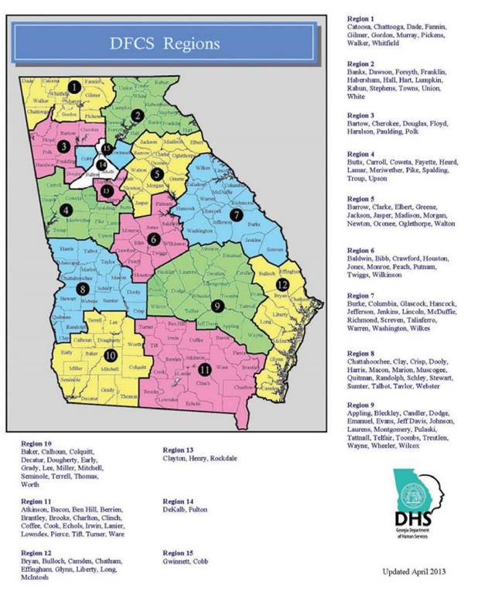
The 15 Statewide Regions

Slide 8
Training Content-3 hours
Identify the Needs of the Participants
What services are you presently providing?
What is your intent on expanding those services?
Is there anything you need, or are lacking that we can help you with?
Introduction of the Three Steps to Family Success
How does this works?
- Graduate from High School, Wait until you are at least 21 to get married, and Have your first child after you are married.
Introduction of DHS Services
Division of Aging Services
Division of Child Support Services
Division of Families and Children Services
The DHS Kiosk
The Faith and Community Alliance Tool Box

Slide 9
The Tool Box
The tool box will contain the following:
DHS Video
Copy of divisions brochures
Regional office locations with contact person name, and contact Information
Kiosk Set-Up Information
Faith and Community Alliance Brochures
Three Steps to Family Success Template

Slide 10
Who should attend the training?
Ministers, and Faith Community Leaders
Those responsible for administering such programs in their place of worship.

Slide 11
Recruitment
Those who have attended past community meetings
Those invited by FCA committee members
Those who heard about the training via public media broadcast
Personal invitations to the churches from the statewide coordinators

Slide 12
Class Size
The training class size should not exceed 25 participants to allow maximum participation.

Slide 13
Who will provide the training?
DHS Statewide Coordinators
DHS Division local Representatives
Occasionally members from DHS Executive Team

Slide 14
Each participant will receive a framed certificate of completion to be displayed at their place of worship
Partnership

Slide 15
Tentative Training Schedule
January 2015
Atlanta Athens
Cartersville Albany
February 2015
Rome Macon Columbus Savannah

Slide 16
The Committee Structure and Purpose
The committee is composed of multi-denominational churches in the faith community who have a passion for helping those in need. The Department of Human Services (DHS) is honored to be a collaborative partners in this important initiative. This includes the Division of Aging, the Division of Child Support Services, and the Division of Families and Children Services.

Slide 17
Purpose of Committees and Structure
Chair
Each Committee shall have a Chair, Co- Chair, Recorder and Members. The Chairs responsibility is to direct each meeting, and to ensure that the committee is focused upon agreed upon goals.
Co-Chair
The Co-Chair responsibility is to support the Chair and ensure that committee members receive meeting notifications. The Co-Chair also attends any ad hoc task force meeting.
Recorder
The Recorder’s responsibility is to ensure that minutes from each meeting are taken. Members should receive a copy prior to the next scheduled meeting. A copy of the minutes should also be forwarded to the Ministerial Alliance Coordinator. The committee can agree to meet monthly to build committee momentum.

Slide 18
FCA Committees
Vulnerable Children and Families
Elderly Care
Parental Responsibilities
Prison Re-Entry Services
Communications
Fatherhood/Child Support
Mental Health

Slide 19
General Meetings
It is recommended that the groups have their general meeting every other month, which will allow time for the committees to meet. The coordinators will attend all general meetings. Additionally a DHS staff will be assigned to each respective committee locally.

Slide 20
Regional Committee Structure

Slide 21
Community Empowerment
The transfer of community empowerment will occur after the first general meeting, however Statewide Coordinators will be involved and available to provide assistance and support.

