Slide 1

DHS Board Meeting
Kathy Floyd
October 21, 2015

Slide 2
Georgia Council on Aging
      created in 1977
      by the Georgia General Assembly
      to serve in an advisory capacity
        to the Governor
        the Lieutenant Governor
        the General Assembly
        and all state agencies
      regarding aging issues

Slide 3
GCOA Structure
20 members: 10 consumers and 10 providers
Appointed by
  Governor (8)
  Lt Governor (4)
Speaker of the House (4)
  Commissioner of DHS (4)
3 Staff
State Funding
Attached to DHS for Administrative Purposes

Slide 4

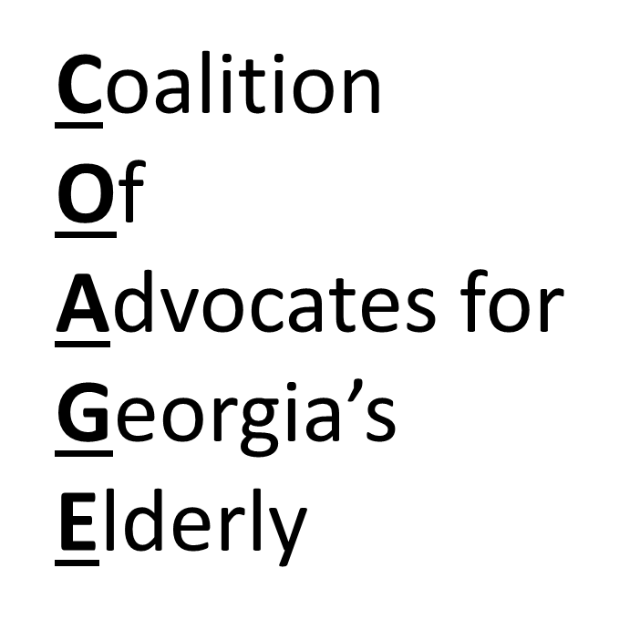
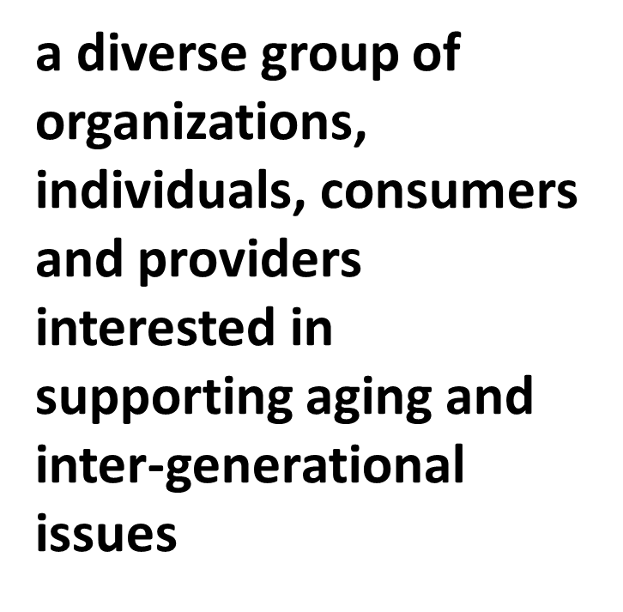
CO-AGE

Slide 5
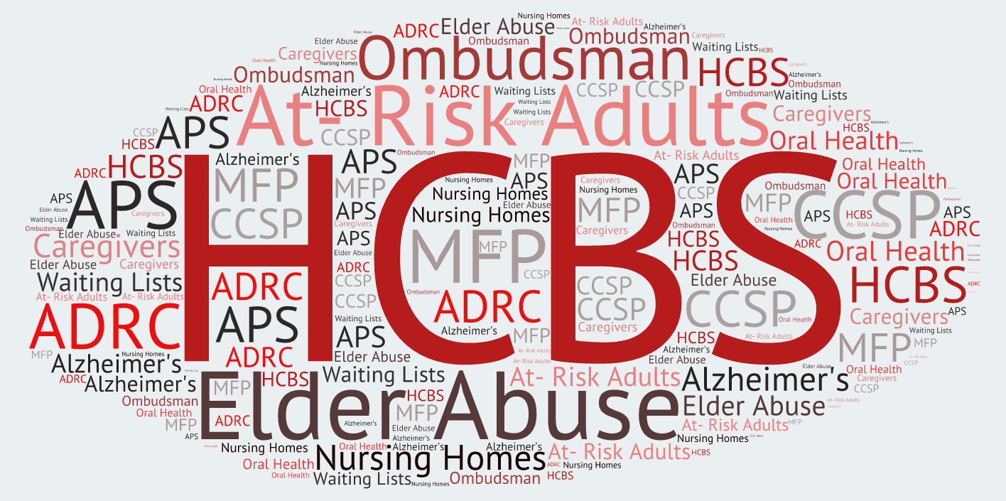

Slide 6
Calendar
April | Call for Issues
July | Voting
August | Work Groups start
Oct – Dec | Educate Legislators
Jan - Mar | General Assembly meets

Slide 7
2016 CO-AGE priorities
Funding for HCBS
Funding for Transitions Services
Abuser Registry
Access to Oral Health Care
Family Care Act

Slide 8
Questions?

