Slide 1
Office of Inspector General
Residential Child Care Licensing Unit:
Reporting 101
Presenter: Tanya Davis Coleman, MSW
Presentation to: CPA/CCI Providers
Date: Fall 2015
Georgia Department of Human Services

Slide 2
Vision, Mission and Core Values
Vision
Stronger Families for a Stronger Georgia.
Mission
Strengthen Georgia by providing Individuals and Families access to services that promote self-sufficiency, independence, and protect Georgia's vulnerable children and adults.
Core Values
Provide access to resources that offer support and empower Georgians and their families.
Deliver services professionally and treat all clients with dignity and respect. Manage business operations effectively and efficiently by aligning resources across the agency.
Promote accountability, transparency and quality in all services we deliver and programs we administer.
Develop our employees at all levels of the agency.

Slide 3
Reporting
True
Or
False
Notes:
We are going to begin by playing a little game of true and false.

Slide 4
True or False…
Incidents have to be submitted to RCC Reports within 24 hours of occurrence including weekends and holidays.
TRUE
Notes:
Even during weekends and holidays reports have to be submitted within 24 hours of the serious occurrence. No calls/voicemail.

Slide 5
True or False…
Once a report is submitted to DFCS/DJJ, you do not have to submit another report to RCCL.
False
Notes:
Until we all (OPM, DJJ, DFCS) get on the same reporting system, you have to submit report separately. Reports should be filled out on our incident reporting form.

Slide 6
True of False….
Planned hospitalizations are reportable to RCCL.
FALSE
Notes:
Planned hospitalizations are not reportable unless complications arise during the hospitalization.

Slide 7
True or False….
Only confirmed cases of child abuse should be submitted to RCCL.
FALSE
Notes:
Any suspicion or allegation made by a child of abuse should be submitted to RCCL, regardless of whether it happened or not and/or if child recants story later.

Slide 8
True or False…
CPS initiated investigations must be reported to RCCL.
TRUE
Notes:
Once the agency/facility learns of a child alleging abuse from DFCS/CPS, it should be reported to RCC. So, if during a panel hearing, DFCS CM visit, therapist/Dr. visit, DFCS makes it known that they are investigation an allegation or if the FP is interviewed by DFCS for an investigation, then it must be reported to RCC regardless of the outcome. Help FPs/CMs understand that they have to report it when DFCS interviews them regarding a complaint.

Slide 9
True or False
Incidents with law enforcement involvement are reportable to RCCL.
TRUE

Slide 10
True or False….
Incidents/injuries to children while they are in school, daycare, or out in the community must to be reported to RCCL.
TRUE
Notes:
Regardless of where an injury or incident happens, it has to be reported to RCCL.

Slide 11
True or False…..
Agencies should conduct their own internal investigations and send information to RCCReports within 3 business days.
FALSE
Notes:
Agencies have 5 working days to submit their internal investigation.

Slide 12
True or False….
A report to RCCL is required within 24 hours of a runaway/elopement only if law enforcement is involved.
FALSE
Notes:
It is important to isolate the runaway reporting requirements from other serious incidents that may have occurred leading up to the runaway or AWOP or may have been alleged to have occurred during the runaway/AWOP incident. Each serious incident would need to comply with the corresponding reporting requirements. For example, 1) if you have a child that runs away following an incident in which he got into a physical altercation with staff and the staff member is alleged to have punched the child in the eye, which led to the child running away; then the reporting requirements for the physical altercation would need to be considered separate from the reporting requirements of the runaway. Similarly, 2) if a child runs away or is AWOP for 3 hours, but upon return alleges that they were sexually abused while on runaway/AWOP status, the reporting requirements for the alleged sexual abuse should be considered separate from the reporting requirements of the runaway/AWOP.
When considering the sole act of a runaway or AWOP, a runaway or AWOP only becomes a reportable incident when the resident has not returned to the facility within 24 hours, regardless of whether or not the police were called (if the police were called for the sole purpose of reporting the runaway or AWOP). However, if the facility has a policy that requires a report be made to RCC within a shorter time frame than that required by the reporting rule, then the failure to comply with policies and procedures may be in violation and cited.
On the other hand, If a child is noticed to have runaway at 2:00 pm and the facility calls the police or reports to DFCS or OPM at 5:00 pm, and the child returns to the facility after 24 hours has elapsed (after 2:00 pm the following day); then a report to RCC is required within 24 hours of the runaway or AWOP. If the facility has not reported the runaway within 24 hours (by 2:00 pm the following day or shortly thereafter) then the facility should be cited for the reporting rule under this circumstance.
In example 1 above, if the child returned to the facility within 24 hours, then the runaway did not need to be reported to RCC, but the allegation of physical abuse or inappropriate discipline needed to be reported to RCC within 24 hours of learning of the altercation and/or allegation of abuse/inappropriate discipline.
In example 2 above, the runaway was not required to be reported to RCC, but the subsequent allegations of abuse needed to be reported upon learning of the allegations.

Slide 13
Questions
Let’s Chat!!
Notes:
Questions

Slide 14
Reporting Tags
CCI
290-2-5.08(7)Tag 861
290-2-5.08(7) (a-g) Tag 862
CPA
290-9-2-.08(6) Tag 1005
290-9-2-.08(6)(a-f) Tag 1006
Notes:
In the interest of time, these are the reporting tags we will discuss today. See handout #2.

Slide 15
Reasons To Submit A Report
Any form of alleged or suspected child abuse or neglect
Injury beyond first aid/ Illness/hospitalization/urgent care
ESIs
Disaster or emergency situations
Law enforcement
Other Serious Occurrences
Notes:
Injury beyond first aid-Illness that sends child to urgent care
ESI-with injury beyond first aid even if the in house physician evaluates/treats the child because of the serious nature of the injury.
ESI threshold for an individual child or the facility/agency- 3x or more times in 1 month with the same child and/or whenever the institution utilizes more than 10 emergency safety interventions for all children in care within a month 30-day period.

Slide 16
RCC Rule Trends
CPA
- CPS initiated investigation not reported to agency
- FP not reporting incidents to agency
CCI
- Elopement/Runaways
- Abuse allegations made against staff
unsubstantiated
Notes:
Jan 2014-June2015 reporting rules citations. These are some of the trends I found of what was cited.

Slide 17
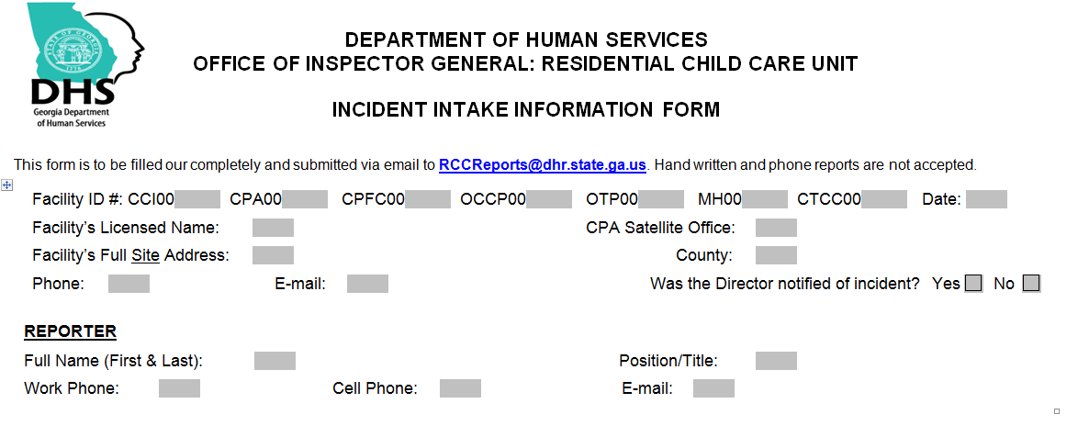
RCC Incident Reporting Form
Notes:
This is a copy of a RCCL Incident reporting form for agencies to use.
FACILITY NAME: This is the legal name of your facility as it appears on your license and every Inspection Report. It might include your corporate name and the DBA name if they are not the same. If you have more than one facility site then you must put the correct name of your facility where the child was admitted.
SITE ADDRESS: For CCI, OCCP, MH and CTCC facilities the FULL ADDRESS is the street address, city and zip code of the actual licensed facility that the child was admitted to. This is not the main or corporate office for those facilities. For CPA & CPFC agencies the FULL ADDRESS is the street address, city and zip code of the licensed agency, not the satellite office.
CCI-write actual site/home/cottage address
If a satellite office-write address of main office and state if it is a satellite office
PHONE and E-MAIL: Indicate either the main phone number and e-mail address of the facility or the Director’s phone number and e-mail address.
REPORTER: This is the FULL NAME, first and last, of the person that your facility authorized to file the self reported incident with RCC. As such, this is who RCC would expect to contact (via phone and/or e-mail) if follow-up information is needed regarding this report. If someone is filing the report for another person then please cc that other person so we can reply to all if we have questions.

Slide 18
Reporting Form
Notes:
REASON FOR REPORT: This should capture the nature of the serious occurrence that caused you to make the report. The boxes are based on reporting requirements found in the rules. Check all of the boxes that apply.
Physical & Sexual Abuse: If the child is alleging abuse by either staff or another child then Physical or Sexual Abuse. This would be checked even if its credibility has not yet been determined. That is considered the allegation. Allegations of abuse and corporal punishment are both put under physical abuse. You may type in corporal punishment for clarification.
Verbal or Emotional Abuse: This are put under Other Serious Occurrence.
Suicidal Actions: This includes serious self-harming actions, suicide attempts. Describe in the incident report any self-harming injuries including bruising from items wrapped around the child’s neck.
Temporary Closure of a Living Unit: This might include fire, power outage, unsafe conditions, flooding etc.
Law Enforcement: Any time law enforcement is called to deal with a situation effecting one or more residents regardless of whether a police report was filed or not should be reported.
Emergency Safety Intervention: This is for the ESI threshold reports.
CPS NOTIFICATION: This section is where you document if someone from your staff made a CPS referral. This is required for all allegations of abuse, sexual exploitation or neglect by law.

Slide 19
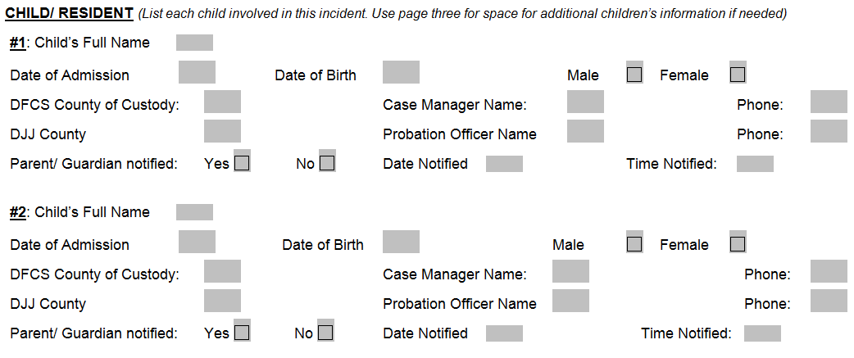
Reporting Form
Notes:
CHILD/RESIDENT: All of the information contained in this section is required for each child actively involved in each incident whether they are the victim, the perpetrator or had just participated in the incident. To add more children into the IIIF in Word format, you may copy the Child #2 section, paste it below Child #2 and rename it to Child #3. If using the form in Adobe then you would have to add it into the unused space on page 3. It might look like this: Abraham Lincoln, DOB: 2/12/1809, DOA: 6/15/1819; DFCS COC: Fulton, CM: Andrew Johnson, 404-555-1212, DJJ: Fulton, Robert Lee, 404-555-1234. This is also where you would document the date and time the Parent/Guardian/Placing agency was contacted. If the child was placed by either DFCS or DJJ then this would be the child’s CM or Probation Officer. The facility itself or the director of the facility/agency does not hold guardianship when they are placed with you unless the court has legally given you sole guardianship.

Slide 20
Reporting Form
Notes:
FOSTER PARENT/ADOPTIVE PARENT: This is to be filled in only if the child was placed in a foster home or adoptive home and not in a facility. CCI, OCCP, MH and CTCC staff are not considered foster parents even if they are house parents.

Slide 21
Reporting Form
Notes:
WITNESS: This is a person, not already named as a child or staff/foster parent, who was present and witnessed the incident. This person did not actively participate in the incident.

Slide 22
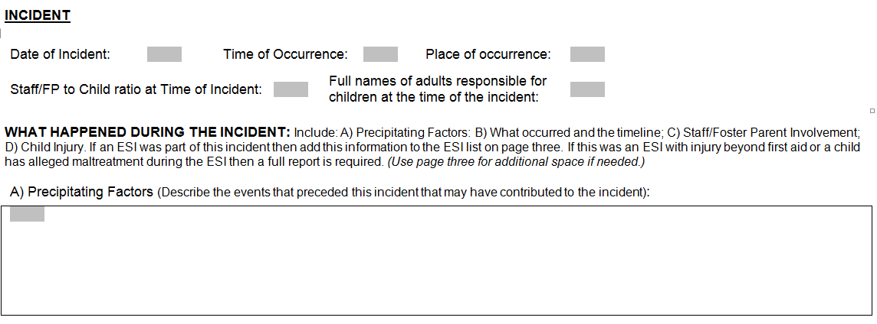
Reporting Form
Notes:
INCIDENT:
Date: This is the date and time (AM/PM) of the actual incident and not the date the facility was informed of the incident. That information goes below into part B) What Occurred.
Place of Occurrence: This is the location of the incident within the facility/foster home, cottage etc. such as child's bedroom and/or the cottage name. If it occurred away from the facility then name that location (Wal-Mart, Miller Park etc.).
Staff/FP to Child Ratio at the Time of the Incident: This should only include staff or foster parents that were responsible for the direct supervision of the children named in the incident as the incident was occurring. If other staff/foster parents were on site (in another cottage, outside in the neighborhood etc.) but not with the children at that time, then they are not included in this ratio.
Full names of adults responsible for children at the time of the incident: This is the first and last name of the staff who were supervising and anyone who assisted with the incident during any part of the incident. If the report refers to a staff member by initials then that person must be entered in this section for identification purposes.
WHAT HAPPENED DURING THE INCIDENT: This section has been broken down into 4 parts to give greater clarity to both the writer and the reader of the report. Please do not use the generic terms such as “staff” or “foster parent” when describing the incident in the sections below. You may refer to a staff member/foster parent by any identifying manner as long as their full name is listed above. This can be initials, first name, last name etc.
Precipitating Factors: This is the description of the events that preceded this incident which may have contributed to the event. This may have been something that occurred earlier in the day or just before incident. It may have involved another child, staff, teachers or even a phone call.

Slide 23
Notes:
What Occurred and Timeline: This is a sequential description of what occurred during the entire incident (not just the part that made it reportable). The timeline is the sequence of the actual incident involving the children, not the sequence based on the person reporting and what that person did. If any form of abuse (verbal, physical, sexual), corporal punishment or neglect allegations were made by a child during this incident, then those allegations would be incorporated into the timeline and description of events. If an ESI was utilized then the that information must also go into the Emergency Safety Interventions Reports on page 3.

Slide 24
Notes:
Staff or Foster Parent Involvement This is where the description of the specific actions staff/foster parents had taken during this event. Including all de-escalation efforts, the general type of ESI utilized (escort, manual hold, seclusion). This would also include any notifications made to the Director, custody holders and probation officers, therapists, law enforcement, CPS, CSI worker etc., and any direct involvement that any of those people may have had in the incident. This can just be a listing rather than a narrative if you prefer.

Slide 25
Reporting Form
Notes:
Child Injury: This would include the details of how the injury occurred regardless of whether the injury was treated by staff or an outside facility. Include the name of the person who may have caused the injury; the date medical attention was given and by who (staff, facility nurse, name of hospital or urgent care center); a description of the injury and the diagnosis, if seen by a medical professional; the extent of the medical care and treatment; and any follow-up needed. If there was a minor injury, which did not require an assessment by an outside medical professional, then indicate the same information as for any injury. If the injury was from an ESI, and the child needed to be assessed by a medical professional at a doctor’s office, an emergency room or urgent care center, then that box is to be checked. If the injury from the ESI was minor and did not require further medical assessment or treatment then do not check the ESI injury box.

Slide 26
Notes:
SAFETY PLAN: STEPS TAKEN BY FACILITY TO PREVENT FUTURE INCIDENTS: This section includes the immediate and long term safety plans that ensure the safety of all children in your care. If there is an alleged perpetrator then include a plan regarding that person’s interactions with children in care. An immediate safety plan might include some of the following: moving children to safety; separating the people involved in the incident; keeping them apart for a period of time; removing whatever might have caused the injury or threat of injury; increasing the level of supervision etc.
If the report was for an illness or an injury that occurred at school or other instance where the child was not supposed to be supervised by the staff/foster parent then a safety plan may not be needed.
Was there a previous safety plan?
Internal Investigation
Short Term
Long Term

Slide 27
Notes:
emergency safety interventions report should be submitted if it occurred three or more times in one month with the same child and/or whenever the institution utilizes more than 10 emergency safety interventions for all children in care within a 30-day period.

Slide 28
Internal Investigation
Submit within 5 business days
Staff/Foster Parent interviews
Resident/Foster child interviews
Witness statements
Written statements
Video footage
Supporting Documentation
Safety Plan/Prevention Plan
Notes:
Additionally, a detailed investigative report which includes steps taken by the facility/agency to prevent similar incidents from occurring is to be completed within five working days. It should be detailed enough to make a determination on the incident and what can be done to make changes so it won’t happen in the future. It may elaborate on or amend the preliminary long term safety plan that was stated in the initial incident report with more specific information. There is no ORCC form for this investigative report. The only restriction is that it not be on an IIIF.
Supporting Documentation-ESI logs, bed check logs, ER discharge paperwork, etc.

Slide 29
Case study
Residents were in the dining hall receiving dinner. Resident 1 and Resident 2 got into a verbal altercation regarding the food. At that point Resident 2 walked over and started striking Resident 1 several times in the face and head with his closed fist. Resident 1 did not strike back he only put his hands up to try and deflect the blows. The police were called and Resident 2 was arrested for the assault.
Notes:
Is this reportable? YES
What makes this reportable?
What is missing from this report? Staff supervision
Where was staff? Did they intervene?
What is the safety plan?

Slide 30
Case Study
FC 1 was sent the emergency room after she had complained at school of being light headed and dizzy. FC 1 told ER doctor that she had taken 3 of her anxiety medications that morning instead of 1 as prescribed, because her head was hurting and she thought it would help.
Notes:
What is the safety plan for this medication management issue?
Where was the medication supposed to be stored? Was it stored there? If not how are you handling the situation with both the foster parent and foster child?

Slide 31
Tips
Subject line
Respond/Reply to RCC emails through RCC reports email
Details, Details, Details
When in doubt, Report!
Notes:
When you are ready to file an incident report put the name of your agency, the child/ren’s name(s) and the date of the incident (if known) in the subject line of the email.
When we do ask for additional information we expect that the response be emailed to RCCReports@dhs.ga.gov within 2 business days

Slide 32
Questions…

